Slide 1
Introduction to HPC Workshop
October 22 2015

Slide 2
Introduction
Rob Lane
&
The HPC Support Team
Research Computing Services
CUIT

Slide 3
Introduction
HPC Basics

Slide 4
Introduction
Third HPC Workshop

Slide 5
Introduction
We have 2 clusters
Yeti
Hotfoot

Slide 6
Yeti
2 head nodes
167 execute nodes
200 TB storage

Slide 7
Yeti
Configuration | 1st Round | 2nd Round
CPU | E5-2650L | E5-2650v2
GPU | Nvidia K20 | Nvidia K40
64 GB Memory | 38 | 10
128 GB Memory | 8 | 0
256 GB Memory | 35 | 3
Infiniband | 16 | 48
GPU | 4 | 5
Total Systems | 101 | 66

Slide 8
Yeti
Configuration | 1st Round | 2nd Round
CPU | E5-2650L | E5-2650v2
Cores | 8 | 8
Speed GHz | 1.8 | 2.6
FLOPS | 115.2 | 166.4

Slide 9
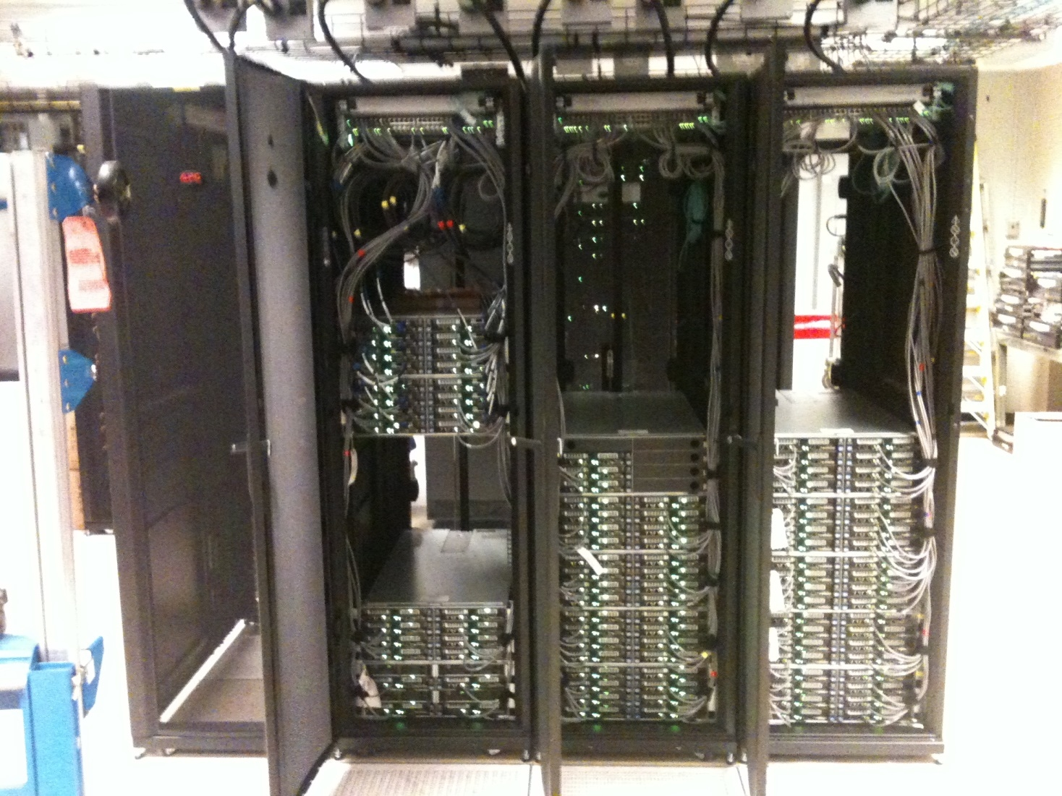
Yeti

Slide 10
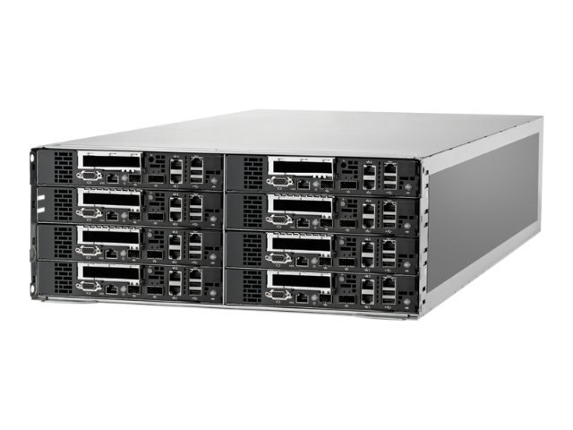
HP S6500 Chassis

Slide 11
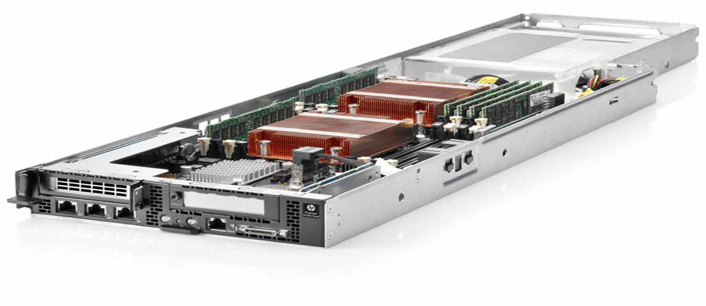
HP SL230 Server

Slide 12
Hotfoot
2 head nodes
30 execute nodes
70 TB storage

Slide 13
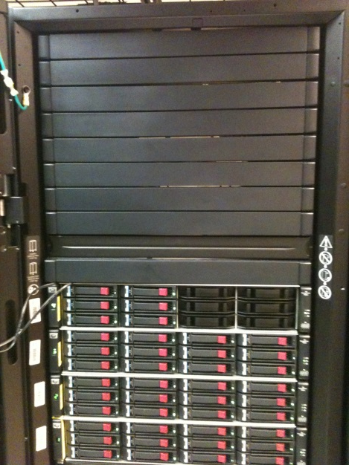
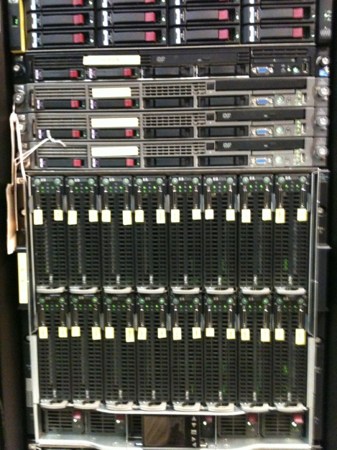
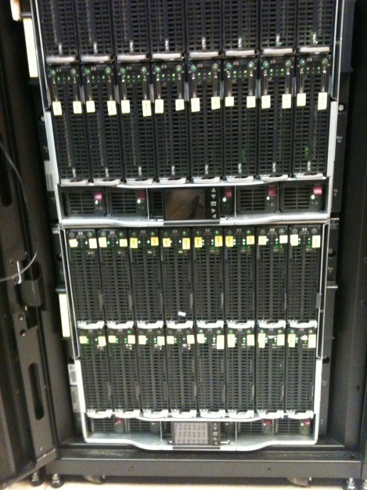
Hotfoot
Empty Space | Servers | Execute Nodes
Storage | Execute Nodes

Slide 14
Job Scheduler
Manages the cluster
Decides when a job will run
Decides where a job will run
We use Torque/Moab

Slide 15
Job Queues
Jobs are submitted to a queue
Jobs sorted in priority order
Not a FIFO

Slide 16
Access
Mac Instructions
Run terminal

Slide 17
Access
Windows Instructions
Search for putty on Columbia home page
Select first result
Follow link to Putty download page
Download putty.exe
Run putty.exe

Slide 18
Access
Mac (Terminal)
$ ssh UNI@hpcsubmit.cc.columbia.edu
Windows (Putty)
Host Name: hpcsubmit.cc.columbia.edu

Slide 19
Work Directory
$ cd /hpc/edu/users/your UNI
Replace “your UNI” with your UNI
$ cd /hpc/edu/users/hpc2108

Slide 20
Copy Workshop Files
Files are in /tmp/workshop
$ cp /tmp/workshop/* .

Slide 21
Editing
No single obvious choice for editor
vi – simple but difficult at first
emacs – powerful but complex
nano – simple but not really standard

Slide 22
nano
$ nano hellosubmit
“^” means “hold down control”
^a : go to beginning of line
^e : go to end of line
^k: delete line
^o: save file
^x: exit

Slide 23
hellosubmit
#!/bin/sh
# Directives
#PBS -N HelloWorld
#PBS -W group_list=hpcedu
#PBS -l nodes=1:ppn=1,walltime=00:01:00,mem=20mb
#PBS -M UNI@columbia.edu
#PBS -m abe
#PBS -V
# Set output and error directories
#PBS -o localhost:/hpc/edu/users/UNI/
#PBS -e localhost:/hpc/edu/users/UNI/
# Print "Hello World"
echo "Hello World"
# Sleep for 10 seconds
sleep 10
# Print date and time
date

Slide 24
hellosubmit
#!/bin/sh
# Directives
#PBS -N HelloWorld
#PBS -W group_list=hpcedu
#PBS -l nodes=1:ppn=1,walltime=00:01:00,mem=20mb
#PBS -M UNI@columbia.edu
#PBS -m abe
#PBS -V
# Set output and error directories
#PBS -o localhost:/hpc/edu/users/UNI/
#PBS -e localhost:/hpc/edu/users/UNI/
# Print "Hello World"
echo "Hello World"
# Sleep for 20 seconds
sleep 20
# Print date and time
date

Slide 25
hellosubmit
#!/bin/sh
# Directives
#PBS -N HelloWorld
#PBS -W group_list=hpcedu
#PBS -l nodes=1:ppn=1,walltime=00:01:00,mem=20mb
#PBS -M UNI@columbia.edu
#PBS -m abe
#PBS -V

Slide 26
hellosubmit
#!/bin/sh
# Directives
#PBS -N HelloWorld
#PBS -W group_list=hpcedu
#PBS -l nodes=1:ppn=1,walltime=00:01:00,mem=20mb
#PBS -M UNI@columbia.edu
#PBS -m abe
#PBS -V

Slide 27
hellosubmit
#!/bin/sh
# Directives
#PBS -N HelloWorld
#PBS -W group_list=hpcedu
#PBS -l nodes=1:ppn=1,walltime=00:01:00,mem=20mb
#PBS -M UNI@columbia.edu
#PBS -m abe
#PBS -V

Slide 28
hellosubmit
#!/bin/sh
# Directives
#PBS -N HelloWorld
#PBS -W group_list=hpcedu
#PBS -l nodes=1:ppn=1,walltime=00:01:00,mem=20mb
#PBS -M UNI@columbia.edu
#PBS -m abe
#PBS -V

Slide 29
hellosubmit
#!/bin/sh
# Directives
#PBS -N HelloWorld
#PBS -W group_list=hpcedu
#PBS -l nodes=1:ppn=1,walltime=00:01:00,mem=20mb
#PBS -M UNI@columbia.edu
#PBS -m abe
#PBS -V

Slide 30
hellosubmit
#!/bin/sh
# Directives
#PBS -N HelloWorld
#PBS -W group_list=hpcedu
#PBS -l nodes=1:ppn=1,walltime=00:01:00,mem=20mb
#PBS -M UNI@columbia.edu
#PBS -m abe
#PBS -V

Slide 31
hellosubmit
#!/bin/sh
# Directives
#PBS -N HelloWorld
#PBS -W group_list=hpcedu
#PBS -l nodes=1:ppn=1,walltime=00:01:00,mem=20mb
#PBS -M UNI@columbia.edu
#PBS -m abe
#PBS -V

Slide 32
hellosubmit
#!/bin/sh
# Directives
#PBS -N HelloWorld
#PBS -W group_list=hpcedu
#PBS -l nodes=1:ppn=1,walltime=00:01:00,mem=20mb
#PBS -M UNI@columbia.edu
#PBS -m abe
#PBS -V

Slide 33
hellosubmit
#!/bin/sh
# Directives
#PBS -N HelloWorld
#PBS -W group_list=hpcedu
#PBS -l nodes=1:ppn=1,walltime=00:01:00,mem=20mb
#PBS -M UNI@columbia.edu
#PBS -m abe
#PBS -V

Slide 34
hellosubmit
#!/bin/sh
# Directives
#PBS -N HelloWorld
#PBS -W group_list=hpcedu
#PBS -l nodes=1:ppn=1,walltime=00:01:00,mem=20mb
#PBS -M UNI@columbia.edu
#PBS -m abe
#PBS -V

Slide 35
hellosubmit
#!/bin/sh
# Directives
#PBS -N HelloWorld
#PBS -W group_list=hpcedu
#PBS -l nodes=1:ppn=1,walltime=00:01:00,mem=20mb
#PBS -M UNI@columbia.edu
#PBS -m n
#PBS -V

Slide 36
hellosubmit
#!/bin/sh
# Directives
#PBS -N HelloWorld
#PBS -W group_list=hpcedu
#PBS -l nodes=1:ppn=1,walltime=00:01:00,mem=20mb
#PBS -M UNI@columbia.edu
#PBS -m n
#PBS -V

Slide 37
hellosubmit
# Set output and error directories
#PBS -o localhost:/hpc/edu/users/UNI/
#PBS -e localhost:/hpc/edu/users/UNI/

Slide 38
hellosubmit
# Set output and error directories
#PBS -o localhost:/hpc/edu/users/UNI/
#PBS -e localhost:/hpc/edu/users/UNI/

Slide 39
hellosubmit
# Print "Hello World"
echo "Hello World"
# Sleep for 20 seconds
sleep 20
# Print date and time
date

Slide 40
hellosubmit
$ qsub hellosubmit

Slide 41
hellosubmit
$ qsub hellosubmit
739369.mahimahi.cc.columbia.edu
$

Slide 42
hellosubmit
$ qsub hellosubmit
739369.mahimahi.cc.columbia.edu
$

Slide 43
qstat
$ qsub hellosubmit
739369.mahimahi.cc.columbia.edu
$ qstat 739369
Job ID Name User Time Use S Queue
---------- ------------ ---------- -------- - -----
739369.mah HelloWorld hpc2108 0 Q batch1

Slide 44
hellosubmit
$ qsub hellosubmit
739369.mahimahi.cc.columbia.edu
$ qstat 739369
Job ID Name User Time Use S Queue
---------- ------------ ---------- -------- - -----
739369.mah HelloWorld hpc2108 0 Q batch1

Slide 45
hellosubmit
$ qsub hellosubmit
739369.mahimahi.cc.columbia.edu
$ qstat 739369
Job ID Name User Time Use S Queue
---------- ------------ ---------- -------- - -----
739369.mah HelloWorld hpc2108 0 Q batch1

Slide 46
hellosubmit
$ qsub hellosubmit
739369.mahimahi.cc.columbia.edu
$ qstat 739369
Job ID Name User Time Use S Queue
---------- ------------ ---------- -------- - -----
739369.mah HelloWorld hpc2108 0 Q batch1

Slide 47
hellosubmit
$ qsub hellosubmit
739369.mahimahi.cc.columbia.edu
$ qstat 739369
Job ID Name User Time Use S Queue
---------- ------------ ---------- -------- - -----
739369.mah HelloWorld hpc2108 0 Q batch1

Slide 48
hellosubmit
$ qsub hellosubmit
739369.mahimahi.cc.columbia.edu
$ qstat 739369
Job ID Name User Time Use S Queue
---------- ------------ ---------- -------- - -----
739369.mah HelloWorld hpc2108 0 Q batch1

Slide 49
hellosubmit
$ qsub hellosubmit
739369.mahimahi.cc.columbia.edu
$ qstat 739369
Job ID Name User Time Use S Queue
---------- ------------ ---------- -------- - -----
739369.mah HelloWorld hpc2108 0 Q batch1
$ qstat 739369
qstat: Unknown Job Id Error 739369.mahimahi.cc.columbi

Slide 50
hellosubmit
$ ls -l
total 4
-rw------- 1 hpc2108 hpcedu 398 Oct 8 22:13 hellosubmit
-rw------- 1 hpc2108 hpcedu 0 Oct 8 22:44 HelloWorld.e739369
-rw------- 1 hpc2108 hpcedu 41 Oct 8 22:44 HelloWorld.o739369

Slide 51
hellosubmit
$ ls -l
total 4
-rw------- 1 hpc2108 hpcedu 398 Oct 8 22:13 hellosubmit
-rw------- 1 hpc2108 hpcedu 0 Oct 8 22:44 HelloWorld.e739369
-rw------- 1 hpc2108 hpcedu 41 Oct 8 22:44 HelloWorld.o739369

Slide 52
hellosubmit
$ ls -l
total 4
-rw------- 1 hpc2108 hpcedu 398 Oct 8 22:13 hellosubmit
-rw------- 1 hpc2108 hpcedu 0 Oct 8 22:44 HelloWorld.e739369
-rw------- 1 hpc2108 hpcedu 41 Oct 8 22:44 HelloWorld.o739369

Slide 53
hellosubmit
$ ls -l
total 4
-rw------- 1 hpc2108 hpcedu 398 Oct 8 22:13 hellosubmit
-rw------- 1 hpc2108 hpcedu 0 Oct 8 22:44 HelloWorld.e739369
-rw------- 1 hpc2108 hpcedu 41 Oct 8 22:44 HelloWorld.o739369

Slide 54
hellosubmit
$ ls -l
total 4
-rw------- 1 hpc2108 hpcedu 398 Oct 8 22:13 hellosubmit
-rw------- 1 hpc2108 hpcedu 0 Oct 8 22:44 HelloWorld.e739369
-rw------- 1 hpc2108 hpcedu 41 Oct 8 22:44 HelloWorld.o739369

Slide 55
hellosubmit
$ cat HelloWorld.o739369
Hello World
Thu Oct 9 12:44:05 EDT 2014

Slide 56
hellosubmit
$ cat HelloWorld.o739369
Hello World
Thu Oct 9 12:44:05 EDT 2014
Any Questions?

Slide 57
Interactive
Most jobs run as “batch”
Can also run interactive jobs
Get a shell on an execute node
Useful for development, testing, troubleshooting

Slide 58
Interactive
$ cat interactive
qsub -I -W group_list=hpcedu -l walltime=5:00,mem=100mb

Slide 59
Interactive
$ cat interactive
qsub [ … ] -q interactive

Slide 60
Interactive
$ cat interactive
qsub -I -W group_list=hpcedu -l walltime=5:00,mem=100mb

Slide 61
Interactive
$ cat interactive
qsub -I -W group_list=hpcedu -l walltime=5:00,mem=100mb

Slide 62
Interactive
$ cat interactive
qsub -I -W group_list=hpcedu -l walltime=5:00,mem=100mb

Slide 63
Interactive
$ cat interactive
qsub -I -W group_list=hpcedu -l walltime=5:00,mem=100mb

Slide 64
Interactive
$ cat interactive
qsub -I -W group_list=hpcedu -l walltime=5:00,mem=100mb

Slide 65
Interactive
$ qsub -I -W group_list=hpcedu -l walltime=5:00,mem=100mb
qsub: waiting for job 739378.mahimahi.cc.columbia.edu to start

Slide 66
Interactive
qsub: job 739378.mahimahi.cc.columbia.edu ready
;\
|' \
_ ; : ;
/ `-. /: : |
| ,-.`-. ,': : |
\ : `. `. ,'-. : |
\ ; ; `-.__,' `-.|
\ ; ; ::: ,::'`:. `.
\ `-. : ` :. `. \
\ \ , ; ,: (\
\ :., :. ,'o)): ` `-.
,/,' ;' ,::"'`.`---' `. `-._
,/ : ; '" `;' ,--`.
;/ :; ; ,:' ( ,:)
,.,:. ; ,:., ,-._ `. \""'/
'::' `:'` ,'( \`._____.-'"'
;, ; `. `. `._`-. \\
;:. ;: `-._`-.\ \`.
'`:. : |' `. `\ ) \
` ;: | `--\__,'
'` ,'
,-' -hrr-
+--------------------------------+
| |
| You are in an interactive job. |
| |
| Your walltime is 00:05:00 |
| |
+--------------------------------+

Slide 67
Interactive
$ hostname
caligula.cc.columbia.edu

Slide 68
Interactive
$ exit
logout
qsub: job 739378.mahimahi.cc.columbia.edu completed
$

Slide 69
GUI
Can run GUI’s in interactive jobs
Need X Server on your local system
See user documentation for more information

Slide 70
User Documentation
hpc.cc.columbia.edu
Go to “HPC Support”
Click on Hotfoot user documentation

Slide 71
Job Queues
Scheduler puts all jobs into a queue
Queue selected automatically
Queues have different settings

Slide 72
Job Queues – Hotfoot
Queue | Time Limit | Memory Limit | Max. User Run
Batch 1 | 24 hours | 2 GB | 256
Batch 2 | 5 days | 2 GB | 64
Batch 3 | 3 days | 8 GB | 32
Batch 4 | 3 days | 24 GB | 4
Batch 5 | 3 days | None | 2
Interactive | 4 hours | None | 10

Slide 73
Job Queues - Yeti
Queue | Time Limit | Memory Limit | Max. User Run
Batch 0 | 2 hours | 8 GB | 512
Batch 1 | 12 hours | 8 GB | 512
Batch 2 | 12 hours | 16 GB | 128
Batch 3 | 5 days | 16 GB | 64
Batch 4 | 3 days | None | 8
Interactive | 4 hours | None | 4
Infiniband | 1½ days | None | 10
GPU | 3 days | None | 4

Slide 74
qstat -q
$ qstat -q
server: mahimahi.cc.columbia.edu
Queue Memory CPU Time Walltime Node Run Que Lm State
---------------- ------ -------- -------- ---- --- --- -- -----
batch -- -- 120:00:0 -- 0 0 -- D R
batch1 2gb -- 24:00:00 -- 0 0 -- E R
batch2 2gb -- 120:00:0 -- 0 0 -- E R
batch3 8gb -- 72:00:00 -- 7 0 -- E R
batch4 24gb -- 72:00:00 -- 2 0 -- E R
batch5 -- -- 72:00:00 -- 2 5 -- E R
interactive -- -- 04:00:00 -- 0 0 -- E R
long 24gb -- 120:00:0 -- 0 0 -- E R
route -- -- -- -- 0 0 -- E R
----- -----
11 5

Slide 75
qstat -q
$ qstat -q
server: elk.cc.columbia.edu
Queue Memory CPU Time Walltime Node Run Que Lm State
---------------- ------ -------- -------- ---- --- --- -- -----
batch1 4gb -- 12:00:00 -- 17 0 -- E R
batch2 16gb -- 12:00:00 -- 221 41 -- E R
batch3 16gb -- 120:00:0 -- 353 1502 -- E R
batch4 -- -- 72:00:00 -- 30 118 -- E R
interactive -- -- 04:00:00 -- 0 0 -- E R
interlong -- -- 96:00:00 -- 0 0 -- E R
route -- -- -- -- 0 0 -- E R
----- -----
621 1661

Slide 76
email
from: hpc-noreply@columbia.edu
to: hpc2108@columbia.edu
date: Mon, Mar 2, 2015 at 10:38 PM
subject: PBS JOB 739386.mahimahi.cc.columbia.edu
PBS Job Id: 739386.mahimahi.cc.columbia.edu
Job Name: HelloWorld
Exec host: caligula.cc.columbia.edu/2
Execution terminated
Exit_status=0
resources_used.cput=00:00:02
resources_used.mem=8288kb
resources_used.vmem=304780kb
resources_used.walltime=00:02:02
Error_Path: localhost:/hpc/edu/users/hpc2108/HelloWorld.e739386
Output_Path: localhost:/hpc/edu/users/hpc2108/HelloWorld.o739386

Slide 77
email
from: hpc-noreply@columbia.edu
to: hpc2108@columbia.edu
date: Mon, Mar 2, 2015 at 10:38 PM
subject: PBS JOB 739386.mahimahi.cc.columbia.edu
PBS Job Id: 739386.mahimahi.cc.columbia.edu
Job Name: HelloWorld
Exec host: caligula.cc.columbia.edu/2
Execution terminated
Exit_status=0
resources_used.cput=00:00:02
resources_used.mem=8288kb
resources_used.vmem=304780kb
resources_used.walltime=00:02:02
Error_Path: localhost:/hpc/edu/users/hpc2108/HelloWorld.e739386
Output_Path: localhost:/hpc/edu/users/hpc2108/HelloWorld.o739386

Slide 78
email
from: hpc-noreply@columbia.edu
to: hpc2108@columbia.edu
date: Mon, Mar 2, 2015 at 10:38 PM
subject: PBS JOB 739386.mahimahi.cc.columbia.edu
PBS Job Id: 739386.mahimahi.cc.columbia.edu
Job Name: HelloWorld
Exec host: caligula.cc.columbia.edu/2
Execution terminated
Exit_status=0
resources_used.cput=00:00:02
resources_used.mem=8288kb
resources_used.vmem=304780kb
resources_used.walltime=00:02:02
Error_Path: localhost:/hpc/edu/users/hpc2108/HelloWorld.e739386
Output_Path: localhost:/hpc/edu/users/hpc2108/HelloWorld.o739386

Slide 79
email
from: hpc-noreply@columbia.edu
to: hpc2108@columbia.edu
date: Mon, Mar 2, 2015 at 10:38 PM
subject: PBS JOB 739386.mahimahi.cc.columbia.edu
PBS Job Id: 739386.mahimahi.cc.columbia.edu
Job Name: HelloWorld
Exec host: caligula.cc.columbia.edu/2
Execution terminated
Exit_status=0
resources_used.cput=00:00:02
resources_used.mem=8288kb
resources_used.vmem=304780kb
resources_used.walltime=00:02:02
Error_Path: localhost:/hpc/edu/users/hpc2108/HelloWorld.e739386
Output_Path: localhost:/hpc/edu/users/hpc2108/HelloWorld.o739386

Slide 80
email
from: hpc-noreply@columbia.edu
to: hpc2108@columbia.edu
date: Mon, Mar 2, 2015 at 10:38 PM
subject: PBS JOB 739386.mahimahi.cc.columbia.edu
PBS Job Id: 739386.mahimahi.cc.columbia.edu
Job Name: HelloWorld
Exec host: caligula.cc.columbia.edu/2
Execution terminated
Exit_status=0
resources_used.cput=00:00:02
resources_used.mem=8288kb
resources_used.vmem=304780kb
resources_used.walltime=00:02:02
Error_Path: localhost:/hpc/edu/users/hpc2108/HelloWorld.e739386
Output_Path: localhost:/hpc/edu/users/hpc2108/HelloWorld.o739386

Slide 81
email
from: hpc-noreply@columbia.edu
to: hpc2108@columbia.edu
date: Mon, Mar 2, 2015 at 10:38 PM
subject: PBS JOB 739386.mahimahi.cc.columbia.edu
PBS Job Id: 739386.mahimahi.cc.columbia.edu
Job Name: HelloWorld
Exec host: caligula.cc.columbia.edu/2
Execution terminated
Exit_status=0
resources_used.cput=00:00:02
resources_used.mem=8288kb
resources_used.vmem=304780kb
resources_used.walltime=00:02:02
Error_Path: localhost:/hpc/edu/users/hpc2108/HelloWorld.e739386
Output_Path: localhost:/hpc/edu/users/hpc2108/HelloWorld.o739386

Slide 82
email
from: hpc-noreply@columbia.edu
to: hpc2108@columbia.edu
date: Mon, Mar 2, 2015 at 10:38 PM
subject: PBS JOB 739386.mahimahi.cc.columbia.edu
PBS Job Id: 739386.mahimahi.cc.columbia.edu
Job Name: HelloWorld
Exec host: caligula.cc.columbia.edu/2
Execution terminated
Exit_status=0
resources_used.cput=00:00:02
resources_used.mem=8288kb
resources_used.vmem=304780kb
resources_used.walltime=00:02:02
Error_Path: localhost:/hpc/edu/users/hpc2108/HelloWorld.e739386
Output_Path: localhost:/hpc/edu/users/hpc2108/HelloWorld.o739386

Slide 83
email
from: hpc-noreply@columbia.edu
to: hpc2108@columbia.edu
date: Mon, Mar 2, 2015 at 10:38 PM
subject: PBS JOB 739386.mahimahi.cc.columbia.edu
PBS Job Id: 739386.mahimahi.cc.columbia.edu
Job Name: HelloWorld
Exec host: caligula.cc.columbia.edu/2
Execution terminated
Exit_status=0
resources_used.cput=00:00:02
resources_used.mem=8288kb
resources_used.vmem=304780kb
resources_used.walltime=00:02:02
Error_Path: localhost:/hpc/edu/users/hpc2108/HelloWorld.e739386
Output_Path: localhost:/hpc/edu/users/hpc2108/HelloWorld.o739386

Slide 84
MPI
Message Passing Interface
Allows applications to run across multiple computers

Slide 85
MPI
Edit MPI submit file
Compile sample program

Slide 86
MPI
#!/bin/sh
# Directives
#PBS -N MpiHello
#PBS -W group_list=hpcedu
#PBS -l nodes=3:ppn=1,walltime=00:01:00,mem=20mb
#PBS -M UNI@columbia.edu
#PBS -m abe
#PBS -V
# Set output and error directories
#PBS -o localhost:/hpc/edu/users/UNI/
#PBS -e localhost:/hpc/edu/users/UNI/
# Run mpi program.
mpirun mpihello

Slide 87
MPI
#!/bin/sh
# Directives
#PBS -N MpiHello
#PBS -W group_list=hpcedu
#PBS -l nodes=3:ppn=1,walltime=00:01:00,mem=20mb
#PBS -M UNI@columbia.edu
#PBS -m abe
#PBS -V
# Set output and error directories
#PBS -o localhost:/hpc/edu/users/UNI/
#PBS -e localhost:/hpc/edu/users/UNI/
# Run mpi program.
mpirun mpihello

Slide 88
MPI
$ which mpicc
/usr/local/bin/mpicc

Slide 89
MPI
$ which mpicc
/usr/local/bin/mpicc
$ mpicc -o mpihello mpihello.c

Slide 90
MPI
$ which mpicc
/usr/local/bin/mpicc
$ mpicc -o mpihello mpihello.c
$ ls mpihello
mpihello

Slide 91
MPI
$ qsub mpisubmit
739381.mahimahi.cc.columbia.edu

Slide 92
MPI
$ qstat 739381

Slide 93
MPI
$ cat MpiHello.o739381
Hello from worker 1!
Hello from the master!
Hello from worker 2!

Slide 94
MPI – mpihello.c
#include <mpi.h>
#include <stdio.h>
void master(void);
void worker(int rank);
int
main(int argc, char *argv[])
{
int rank;
MPI_Init(&argc, &argv);

Slide 95
MPI – mpihello.c
MPI_Comm_rank(MPI_COMM_WORLD, &rank);
if (rank == 0) {
master();
} else {
worker(rank);
}
MPI_Finalize();
return 0;
}

Slide 96
MPI – mpihello.c
void
master(void)
{
printf("Hello from the master!\n");
}
void
worker(int rank)
{
printf("Hello from worker %d!\n", rank);
}

Slide 97
Yeti Free Tier
Email request to
hpc-support@columbia.edu
Request must come from faculty member or researcher

Slide 98
Questions?
Any questions?

Slide 99
Workshop
We are done with slides
You can run more jobs
General discussion
Hotfoot or Yeti-specific questions

Slide 100
Workshop
Copy any files you wish to keep to your home directory
Please fill out feedback forms
Thanks!

