Slide 1
I wrote a dissertation and you can too
Matt Downs
Getting Ahead: Dissertation Boot Camp
February 25th, 2016

Slide 2
Initial thoughts
Congrats! You’re almost there, but not quite.
Last hurdles:
Dissertation
Gathering your committee
Defending
Congrats! You’re almost there, but not quite.
Last hurdles:
Dissertation
Gathering your committee
Defending

Slide 3
When to start writing
Ideally, after all your research is finished
If not, write when you’re the most focused
Start sooner than you think
DO NOT PROCRASTINATE
Notes:
No facebook/tumblr/twitter/tindr/grinder/clash of clans ect
Write in the morning when you have the most energy

Slide 4
Formatting: Guidelines
Everything you need to know and adhere to:
http://gsas.columbia.edu/content/formatting-guidelines
Notes:
Using page breaks is the easiest way to not have to manually insert the page numbers
Seriously look this over, also Ellie will speak more on formatting and things I wish I knew this time last year

Slide 5
Formatting: General Outline
Required Order |  | Page Numbering
Cover pages and abstract | 1. Title Page | No page numbers; pages are not counted
 | 2. Copyright Page
 | 3. Abstract
Prefatory pages | 1. Table of Contents | Lower case Roman numerals beginning with "i" centered at the bottom of each page
 | 2. List of Charts, Graphs, Illustrations
 | 3. Acknowledgments
 | 4. Dedication
 | 5. Preface (if applicable)
Main body and all other pages | 1. Main body of the dissertation (including all introduction and chapter pages, graphs, photos, figures, and tables) | Arabic numerals beginning with "1" centered at the bottom of each page
 | 2. References and/or Bibliography
 | 3. Appendices (if applicable)

Slide 6
Formatting: Style
Find out the style prior members of your lab/department used
GSAS recommends:
Kate Turabin, A Manual for Writers of Term Papers, Theses, and Dissertations
MLA Style Sheet, New York Modern Language Association of America
The Chicago Manual of Style, University of Chicago Press
Publication Manual, American Psycological Association
Notes:
There is a file format for LaTex online specifically for Columbia’s formatting

Slide 7
The Outline
Writing a clean detailed outline ALWAYS helps fleshing out the rest of the dissertation
Basic outline provided via Formatting Guidelines
Build off of your paper(s)
If you have multiple papers reorganize them in a way to tell a coherent story
Does not have to be linear with time
If you’re more of a visual person, use post-it notes on a wall to reorganize the flow

Slide 8
In The Beginning
Save the abstract for last
Follow normal abstract protocol, but without word limit
Use the introduction as a verbose outline
It’s a glorified abstract
List out your specific aims
Notes:
You’ll be much more clear on the overarching story by the time you’re done writing it
Highlight what each subtopic is for

Slide 9
Background Check
Cover ALL the fundamental information needed in the background section
What research are you building upon?
How does that mathematical model work?
What does this organ do?
Where was the Roman Empire in 1000 AD?
Use the Motivation section to cover WHY
Why are/did you study this topic?
Who does this knowledge apply to?

Slide 10
Chapters
You wrote some papers? Spruce them up and put them here
Transitional paragraph building off of last chapter
As you move forward, note what methods you have already covered
Conversely if you have only written one paper:
Use chapters to go through your research process
Discuss here the intricate methods that took you 6 months, but don’t fit into a paper
List contributions at the end of each chapter
You’re awesome, but not that awesome

Slide 11
And the Ω
End with an Impact section
Tie together the main points from all the prior chapters
Take home message
Your work is important
Future work
Research is never done
Limit when you give this section to your PI to edit

Slide 12
Writing Techniques
The Monastic Way
Taking your time and writing it down line by line
Minimal editing as you’re happy with the way it’s written the first time
Word Vomiting
Write until your hand hurts or you run out of thought
Takes multiple edits to clean up properly

Slide 13
While Writing
Keep in mind your audience
You should want your information to be read easily across departments within your field
Try to avoid colloquial terms or jargons specific to your field
Know when to introduce commonly discussed figures
Insert references as you go

Slide 14
Figures / Equations / Table
Extract the highest quality from your papers
Flow charts are great for showing outline in the introduction
No figure requirement
Have as many figures as necessary to make your point clear
Center figures / tables with captions below
Use equation software
MathCast
MathType

Slide 15
Editing
Don’t edit something you just finished
Give your brain a break from that topic
Do edit sections before moving onto the next
You don’t want plot holes
Don’t worry about formatting the figures properly
Everything will keep shifting around
Do go over everything you’ve finished so far at the end of the week

Slide 16
References
Use software to keep them in order
Mendeley
EndNote
If you reference it, read it
Use the tools in MS word to automatically update references
Seriously I didn’t so this and going through manually changing things is the worst

Slide 17
Personal Deadlines
If you know your defense date, aim to be FINISHED a month ahead of that date
Set personal deadlines and stick to them
The occasional all-nighter can be super productive
Write your dissertation in sections
Facilitates editing by your peers and PI
Allows you to see how far you’ve come along, and how far you need to go

Slide 18
Music
Take time to construct a few good playlists
Switch it up depending on what you’re working on and time of day
Lyric free music tends to be better while constructing first drafts and editing
Working on figures? Go to what gives you the most energy
If you’re using a streaming service, pay for no ads

Slide 19
Writing Location
Go where you are most focused / confortable
If lab isn’t your happy writing space, leave
Switch up locations throughout the day
Find a place that allows you to eat/drink so you don’t have to break your flow
Apartments can work great, but there’s always the danger of the bed and over napping

Slide 20
Breaks
You really need to take breaks
Exercise
Some mindless distraction
Cook
If you’re on/ahead of schedule, take a night off

Slide 21
Cuba, 1960
If you don’t have all your work published yet: Embargo
You can put an embargo on your work for 1-2 years
Title and abstract will still show up during a search

Slide 22
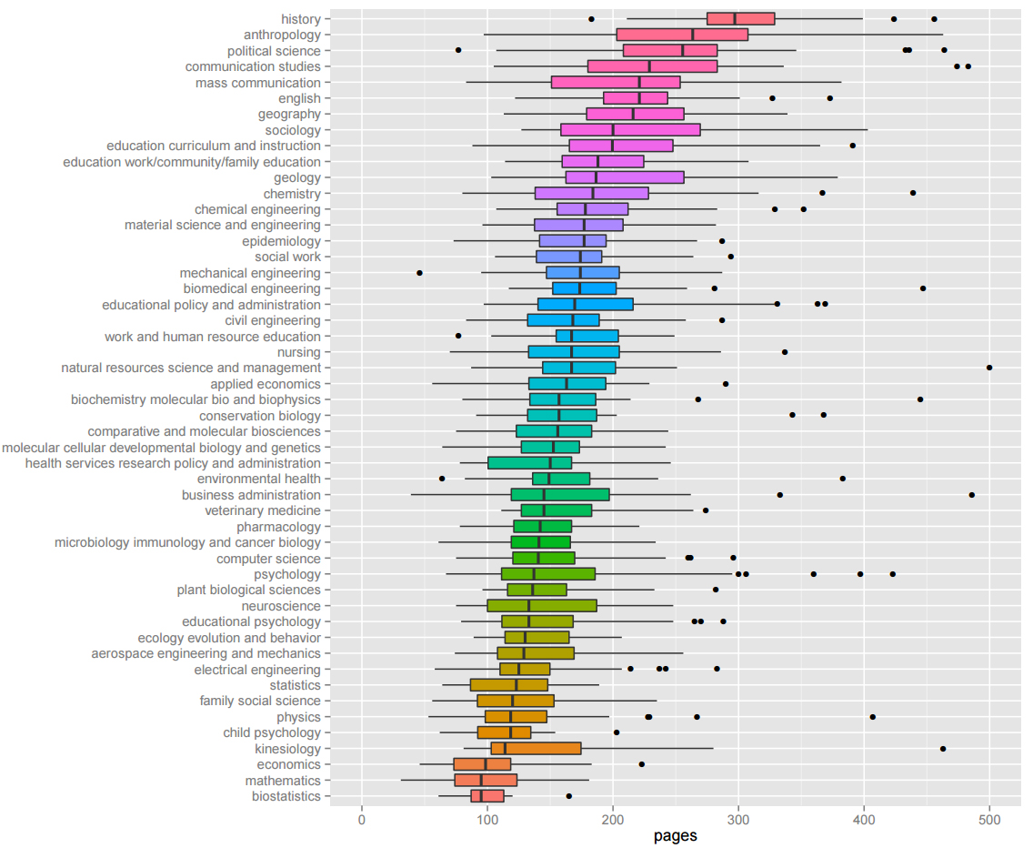
Does size matter?

Slide 23
Questions?

