Slide 1
Introduction to HPC Workshop
March 1st, 2016

Slide 2
Introduction
George Garrett
&
The HPC Support Team
Research Computing Services
CUIT

Slide 3
Introduction
HPC Basics

Slide 4
Introduction
What is HPC?

Slide 5
Introduction
What can you do with HPC?

Slide 6
Yeti
2 head nodes
167 execute nodes
200 TB storage

Slide 7
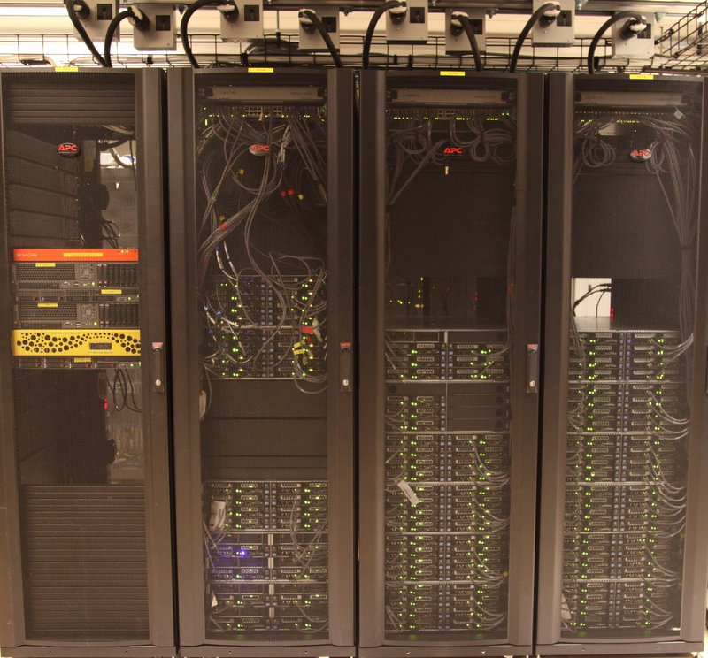
Yeti

Slide 8
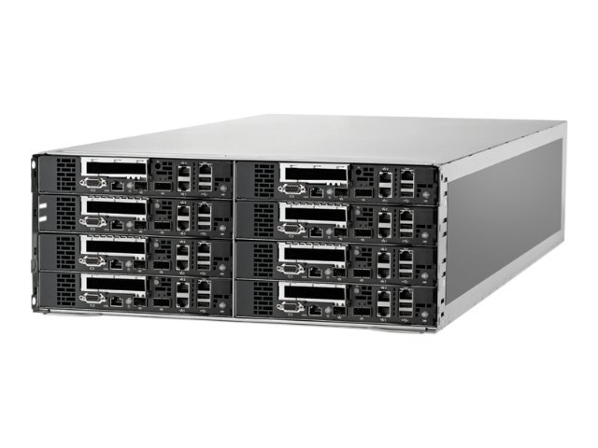
HP S6500 Chassis

Slide 9
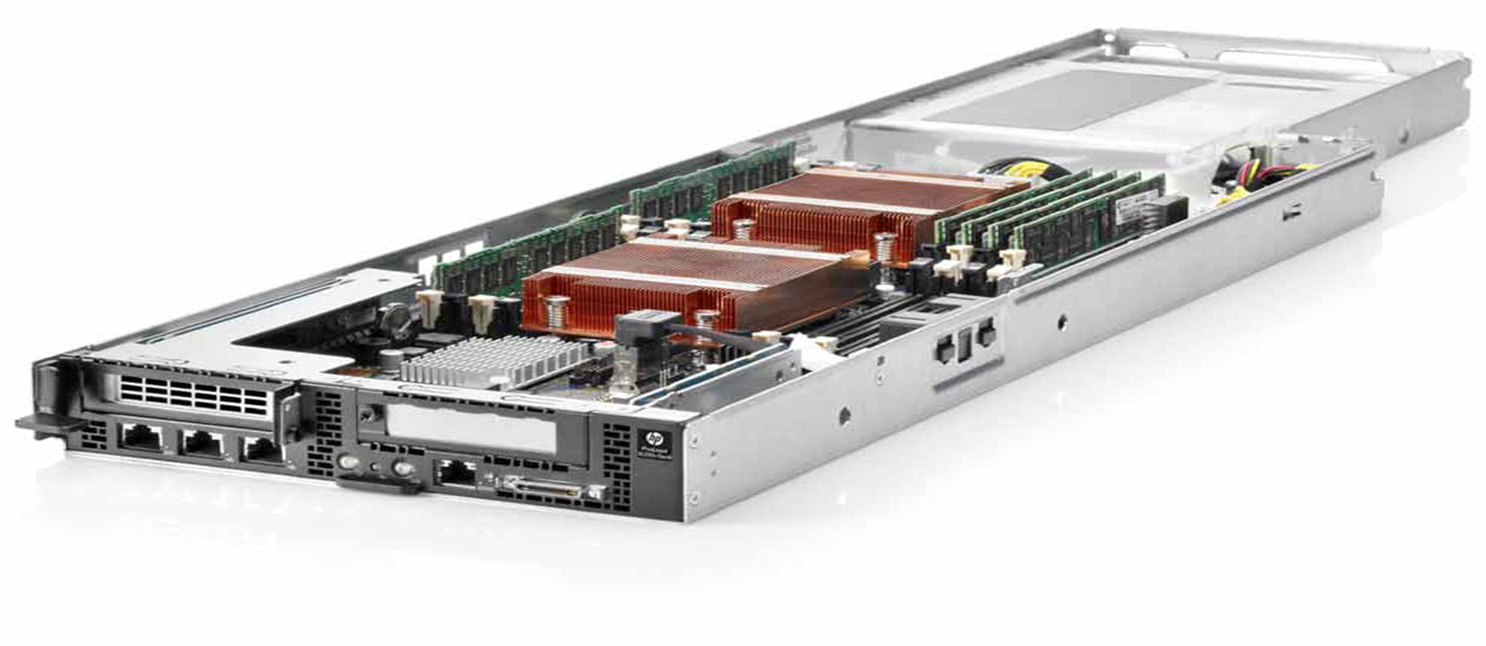
HP SL230 Server

Slide 10
Yeti
Configuration | 1st Round | 2nd Round
CPU | E5-2650L | E5-2650v2
GPU | Nvidia K20 | Nvidia K40
64 GB Memory | 38 | 10
128 GB Memory | 8 | 0
256 GB Memory | 35 | 3
Infiniband | 16 | 48
GPU | 4 | 5
Total Systems | 101 | 66

Slide 11
Yeti
Configuration | 1st Round | 2nd Round
CPU | E5-2650L | E5-2650v2
Cores | 8 | 8
Speed GHz | 1.8 | 2.6
FLOPS | 115.2 | 166.4

Slide 12
Job Scheduler
Manages the cluster
Decides when a job will run
Decides where a job will run
We use Torque/Moab

Slide 13
Job Queues
Jobs are submitted to a queue
Jobs sorted in priority order
Not a FIFO

Slide 14
Access
Mac Instructions
Run terminal

Slide 15
Access
Windows Instructions
Search for putty on Columbia home page
Select first result
Follow link to Putty download page
Download putty.exe
Run putty.exe

Slide 16
Access
Mac (Terminal)
$ ssh UNI@yetisubmit.cc.columbia.edu
Windows (Putty)
Host Name: yetisubmit.cc.columbia.edu

Slide 17
Work Directory
$ cd /vega/free/users/UNI
Replace “UNI” with your UNI
$ cd /vega/free/users/hpc2108

Slide 18
Copy Workshop Files
Files are in /tmp/workshop
$ cp /tmp/workshop/* .

Slide 19
Editing
No single obvious choice for editor
vi – simple but difficult at first
emacs – powerful but complex
nano – simple but not really standard

Slide 20
nano
$ nano hellosubmit
“^” means “hold down control”
^a : go to beginning of line
^e : go to end of line
^k: delete line
^o: save file
^x: exit

Slide 21
hellosubmit
#!/bin/sh
# Directives
#PBS -N HelloWorld
#PBS -W group_list=yetifree
#PBS -l nodes=1:ppn=1,walltime=00:01:00,mem=20mb
#PBS -M UNI@columbia.edu
#PBS -m abe
#PBS -V
# Set output and error directories
#PBS -o localhost:/vega/free/users/UNI/
#PBS -e localhost:/vega/free/users/UNI/
# Print "Hello World"
echo "Hello World"
# Sleep for 10 seconds
sleep 10
# Print date and time
date

Slide 22
hellosubmit
#!/bin/sh
# Directives
#PBS -N HelloWorld
#PBS -W group_list=yetifree
#PBS -l nodes=1:ppn=1,walltime=00:01:00,mem=20mb
#PBS -M UNI@columbia.edu
#PBS -m abe
#PBS -V
# Set output and error directories
#PBS -o localhost:/vega/free/users/UNI/
#PBS -e localhost:/vega/free/users/UNI/
# Print "Hello World"
echo "Hello World"
# Sleep for 20 seconds
sleep 20
# Print date and time
date

Slide 23
hellosubmit
#!/bin/sh
# Directives
#PBS -N HelloWorld
#PBS -W group_list=yetifree
#PBS -l nodes=1:ppn=1,walltime=00:01:00,mem=20mb
#PBS -M UNI@columbia.edu
#PBS -m abe
#PBS -V

Slide 24
hellosubmit
#!/bin/sh
# Directives
#PBS -N HelloWorld
#PBS -W group_list=yetifree
#PBS -l nodes=1:ppn=1,walltime=00:01:00,mem=20mb
#PBS -M UNI@columbia.edu
#PBS -m abe
#PBS -V

Slide 25
hellosubmit
#!/bin/sh
# Directives
#PBS -N HelloWorld
#PBS -W group_list=yetifree
#PBS -l nodes=1:ppn=1,walltime=00:01:00,mem=20mb
#PBS -M UNI@columbia.edu
#PBS -m abe
#PBS -V

Slide 26
hellosubmit
#!/bin/sh
# Directives
#PBS -N HelloWorld
#PBS -W group_list=yetifree
#PBS -l nodes=1:ppn=1,walltime=00:01:00,mem=20mb
#PBS -M UNI@columbia.edu
#PBS -m abe
#PBS -V

Slide 27
hellosubmit
#!/bin/sh
# Directives
#PBS -N HelloWorld
#PBS -W group_list=yetifree
#PBS -l nodes=1:ppn=1,walltime=00:01:00,mem=20mb
#PBS -M UNI@columbia.edu
#PBS -m abe
#PBS -V

Slide 28
hellosubmit
#!/bin/sh
# Directives
#PBS -N HelloWorld
#PBS -W group_list=yetifree
#PBS -l nodes=1:ppn=1,walltime=00:01:00,mem=20mb
#PBS -M UNI@columbia.edu
#PBS -m abe
#PBS -V

Slide 29
hellosubmit
#!/bin/sh
# Directives
#PBS -N HelloWorld
#PBS -W group_list=yetifree
#PBS -l nodes=1:ppn=1,walltime=00:01:00,mem=20mb
#PBS -M UNI@columbia.edu
#PBS -m abe
#PBS -V

Slide 30
hellosubmit
#!/bin/sh
# Directives
#PBS -N HelloWorld
#PBS -W group_list=yetifree
#PBS -l nodes=1:ppn=1,walltime=00:01:00,mem=20mb
#PBS -M UNI@columbia.edu
#PBS -m abe
#PBS -V

Slide 31
hellosubmit
#!/bin/sh
# Directives
#PBS -N HelloWorld
#PBS -W group_list=yetifree
#PBS -l nodes=1:ppn=1,walltime=00:01:00,mem=20mb
#PBS -M UNI@columbia.edu
#PBS -m abe
#PBS -V

Slide 32
hellosubmit
#!/bin/sh
# Directives
#PBS -N HelloWorld
#PBS -W group_list=yetifree
#PBS -l nodes=1:ppn=1,walltime=00:01:00,mem=20mb
#PBS -M UNI@columbia.edu
#PBS -m abe
#PBS -V

Slide 33
hellosubmit
#!/bin/sh
# Directives
#PBS -N HelloWorld
#PBS -W group_list=yetifree
#PBS -l nodes=1:ppn=1,walltime=00:01:00,mem=20mb
#PBS -M UNI@columbia.edu
#PBS -m n
#PBS -V

Slide 34
hellosubmit
#!/bin/sh
# Directives
#PBS -N HelloWorld
#PBS -W group_list=yetifree
#PBS -l nodes=1:ppn=1,walltime=00:01:00,mem=20mb
#PBS -M UNI@columbia.edu
#PBS -m n
#PBS -V

Slide 35
hellosubmit
# Set output and error directories
#PBS -o localhost:/vega/free/users/UNI/
#PBS -e localhost:/vega/free/users/UNI/

Slide 36
hellosubmit
# Set output and error directories
#PBS -o localhost:/vega/free/users/UNI/
#PBS -e localhost:/vega/free/users/UNI/

Slide 37
hellosubmit
# Print "Hello World"
echo "Hello World"
# Sleep for 20 seconds
sleep 20
# Print date and time
date

Slide 38
qsub
$ qsub hellosubmit

Slide 39
hellosubmit
$ qsub hellosubmit
739369.moose.cc.columbia.edu
$

Slide 40
hellosubmit
$ qsub hellosubmit
739369.moose.cc.columbia.edu
$

Slide 41
qstat
$ qsub hellosubmit
739369.moose.cc.columbia.edu
$ qstat 739369
Job ID Name User Time Use S Queue
---------- ------------ ---------- -------- - -----
739369.moo HelloWorld hpc2108 0 Q batch0

Slide 42
hellosubmit
$ qsub hellosubmit
739369.moose.cc.columbia.edu
$ qstat 739369
Job ID Name User Time Use S Queue
---------- ------------ ---------- -------- - -----
739369.moo HelloWorld hpc2108 0 Q batch0

Slide 43
hellosubmit
$ qsub hellosubmit
739369.moose.cc.columbia.edu
$ qstat 739369
Job ID Name User Time Use S Queue
---------- ------------ ---------- -------- - -----
739369.moo HelloWorld hpc2108 0 Q batch0

Slide 44
hellosubmit
$ qsub hellosubmit
739369.moose.cc.columbia.edu
$ qstat 739369
Job ID Name User Time Use S Queue
---------- ------------ ---------- -------- - -----
739369.moo HelloWorld hpc2108 0 Q batch0

Slide 45
hellosubmit
$ qsub hellosubmit
739369.moose.cc.columbia.edu
$ qstat 739369
Job ID Name User Time Use S Queue
---------- ------------ ---------- -------- - -----
739369.moo HelloWorld hpc2108 0 Q batch0

Slide 46
hellosubmit
$ qsub hellosubmit
739369.moose.cc.columbia.edu
$ qstat 739369
Job ID Name User Time Use S Queue
---------- ------------ ---------- -------- - -----
739369.moo HelloWorld hpc2108 0 Q batch0

Slide 47
hellosubmit
$ qsub hellosubmit
739369.moose.cc.columbia.edu
$ qstat 739369
Job ID Name User Time Use S Queue
---------- ------------ ---------- -------- - -----
739369.moo HelloWorld hpc2108 0 Q batch0
$ qstat 739369
qstat: Unknown Job Id Error 739369.moose.cc.columbi

Slide 48
hellosubmit
$ ls -l
total 4
-rw------- 1 hpc2108 yetifree 398 Oct 8 22:13 hellosubmit
-rw------- 1 hpc2108 yetifree 0 Oct 8 22:44 HelloWorld.e739369
-rw------- 1 hpc2108 yetifree 41 Oct 8 22:44 HelloWorld.o739369

Slide 49
hellosubmit
$ ls -l
total 4
-rw------- 1 hpc2108 yetifree 398 Oct 8 22:13 hellosubmit
-rw------- 1 hpc2108 yetifree 0 Oct 8 22:44 HelloWorld.e739369
-rw------- 1 hpc2108 yetifree 41 Oct 8 22:44 HelloWorld.o739369

Slide 50
hellosubmit
$ ls -l
total 4
-rw------- 1 hpc2108 yetifree 398 Oct 8 22:13 hellosubmit
-rw------- 1 hpc2108 yetifree 0 Oct 8 22:44 HelloWorld.e739369
-rw------- 1 hpc2108 yetifree 41 Oct 8 22:44 HelloWorld.o739369

Slide 51
hellosubmit
$ ls -l
total 4
-rw------- 1 hpc2108 yetifree 398 Oct 8 22:13 hellosubmit
-rw------- 1 hpc2108 yetifree 0 Oct 8 22:44 HelloWorld.e739369
-rw------- 1 hpc2108 yetifree 41 Oct 8 22:44 HelloWorld.o739369

Slide 52
hellosubmit
$ ls -l
total 4
-rw------- 1 hpc2108 yetifree 398 Oct 8 22:13 hellosubmit
-rw------- 1 hpc2108 yetifree 0 Oct 8 22:44 HelloWorld.e739369
-rw------- 1 hpc2108 yetifree 41 Oct 8 22:44 HelloWorld.o739369

Slide 53
hellosubmit
$ cat HelloWorld.o739369
Hello World
Thu Oct 9 12:44:05 EDT 2014

Slide 54
hellosubmit
$ cat HelloWorld.o739369
Hello World
Thu Oct 9 12:44:05 EDT 2014
Any Questions?

Slide 55
Interactive
Most jobs run as “batch”
Can also run interactive jobs
Get a shell on an execute node
Useful for development, testing, troubleshooting

Slide 56
Interactive
$ cat interactive
qsub -I -W group_list=yetifree -l walltime=5:00,mem=100mb

Slide 57
Interactive
$ cat interactive
qsub -I -W group_list=yetifree -l walltime=5:00,mem=100mb

Slide 58
Interactive
$ cat interactive
qsub -I -W group_list=yetifree -l walltime=5:00,mem=100mb

Slide 59
Interactive
$ cat interactive
qsub -I -W group_list=yetifree -l walltime=5:00,mem=100mb

Slide 60
Interactive
$ cat interactive
qsub -I -W group_list=yetifree -l walltime=5:00,mem=100mb

Slide 61
Interactive
$ cat interactive
qsub -I -W group_list=yetifree -l walltime=5:00,mem=100mb

Slide 62
Interactive
$ qsub -I -W group_list=yetifree -l walltime=5:00,mem=100mb
qsub: waiting for job 739378.moose.cc.columbia.edu to start

Slide 63
Interactive
qsub: job 1847997.moose.cc.columbia.edu ready
.--.
,-,-,--(/o o\)-,-,-,.
,' // oo \\ ',
,' /| __ |\ ',
,' //\,__,/\\ ',
, /\ /\ ,
, /'`\ /' \ ,
| /' `\ /' '\ |
| \ ( ) / |
( /\| /' '\ |/\ )
\| /' /'`\ '\ |/
| /' `\ |
( ( ) )
`\ \ /' /'
`\ \ /' /'
/ / \ \
v v v v v v
+--------------------------------+
| You are in an interactive job. |
| Your walltime is 00:05:00 |
+--------------------------------+
dallas$

Slide 64
Interactive
$ hostname
dallas.cc.columbia.edu

Slide 65
Interactive
$ exit
logout
qsub: job 739378.moose.cc.columbia.edu completed
$

Slide 66
GUI
Can run GUI’s in interactive jobs
Need X Server on your local system
See user documentation for more information

Slide 67
User Documentation
hpc.cc.columbia.edu
Go to “HPC Support”
Click on Yeti user documentation

Slide 68
Job Queues
Scheduler puts all jobs into a queue
Queue selected automatically
Queues have different settings

Slide 69
Batch Job Queues
Queue | Time Limit | Memory Limit | Max. User Run
Route | n/a | n/a | n/a
Batch 0 | 2 hours | 8 GB | 512
Batch 1 | 12 hours | 8 GB | 512
Batch 2 | 12 hours | 16 GB | 128
Batch 3 | 5 days | 16 GB | 64
Batch 4 | 3 days | None | 8

Slide 70
Infiniband Job Queues
Queue | Time Limit | Memory Limit | Max. User Run
Infiniband | n/a | n/a | n/a
IB2 | 2 hours | None | 10
IB12 | 12 hours | None | 10
IB48 | 48 hours | None | 10

Slide 71
GPU Job Queues
Queue | Time Limit | Memory Limit | Max. User Run
GPU | n/a | n/a | n/a
GPU 2 | 2 hours | None | 4
GPU 12 | 12 hours | None | 4
GPU 72 | 3 days | None | 4

Slide 72
Other Job Queues
Queue | Time Limit | Memory Limit | Max. User Run
Interactive | 4 hours | None | 4
Special Request | Varies | Varies | Varies

Slide 73
qstat -q
$ qstat -q
server: moose.cc.columbia.edu
Queue Memory CPU Time Walltime Node Run Que Lm State
---------------- ------ -------- -------- ---- --- --- -- -----
batch0 8gb -- 02:00:00 -- 0 1 -- E R
batch1 8gb -- 12:00:00 -- 660 265 -- E R
batch2 16gb -- 12:00:00 -- 221 41 -- E R
batch3 16gb -- 120:00:0 -- 353 1502 -- E R
batch4 -- -- 72:00:00 -- 30 118 -- E R
interactive -- -- 04:00:00 -- 0 0 -- E R
interlong -- -- 96:00:00 -- 0 0 -- E R
route -- -- -- -- 0 0 -- E R
----- -----
1264 1927

Slide 74
email
from: hpc-noreply@columbia.edu
to: hpc2108@columbia.edu
date: Mon, Mar 2, 2015 at 10:38 PM
subject: PBS JOB 739386.moose.cc.columbia.edu
PBS Job Id: 739386.moose.cc.columbia.edu
Job Name: HelloWorld
Exec host: dallas.cc.columbia.edu/2
Execution terminated
Exit_status=0
resources_used.cput=00:00:02
resources_used.mem=8288kb
resources_used.vmem=304780kb
resources_used.walltime=00:02:02
Error_Path: localhost:/vega/free/users/hpc2108/HelloWorld.e739386
Output_Path: localhost:/vega/free/users/hpc2108/HelloWorld.o739386

Slide 75
email
from: hpc-noreply@columbia.edu
to: hpc2108@columbia.edu
date: Mon, Mar 2, 2015 at 10:38 PM
subject: PBS JOB 739386.moose.cc.columbia.edu
PBS Job Id: 739386.moose.cc.columbia.edu
Job Name: HelloWorld
Exec host: dallas.cc.columbia.edu/2
Execution terminated
Exit_status=0
resources_used.cput=00:00:02
resources_used.mem=8288kb
resources_used.vmem=304780kb
resources_used.walltime=00:02:02
Error_Path: localhost:/vega/free/users/hpc2108/HelloWorld.e739386
Output_Path: localhost:/vega/free/users/hpc2108/HelloWorld.o739386

Slide 76
email
from: hpc-noreply@columbia.edu
to: hpc2108@columbia.edu
date: Mon, Mar 2, 2015 at 10:38 PM
subject: PBS JOB 739386.moose.cc.columbia.edu
PBS Job Id: 739386.moose.cc.columbia.edu
Job Name: HelloWorld
Exec host: dallas.cc.columbia.edu/2
Execution terminated
Exit_status=0
resources_used.cput=00:00:02
resources_used.mem=8288kb
resources_used.vmem=304780kb
resources_used.walltime=00:02:02
Error_Path: localhost:/vega/free/users/hpc2108/HelloWorld.e739386
Output_Path: localhost:/vega/free/users/hpc2108/HelloWorld.o739386

Slide 77
email
from: hpc-noreply@columbia.edu
to: hpc2108@columbia.edu
date: Mon, Mar 2, 2015 at 10:38 PM
subject: PBS JOB 739386.moose.cc.columbia.edu
PBS Job Id: 739386.moose.cc.columbia.edu
Job Name: HelloWorld
Exec host: dallas.cc.columbia.edu/2
Execution terminated
Exit_status=0
resources_used.cput=00:00:02
resources_used.mem=8288kb
resources_used.vmem=304780kb
resources_used.walltime=00:02:02
Error_Path: localhost:/vega/free/users/hpc2108/HelloWorld.e739386
Output_Path: localhost:/vega/free/users/hpc2108/HelloWorld.o739386

Slide 78
email
from: hpc-noreply@columbia.edu
to: hpc2108@columbia.edu
date: Mon, Mar 2, 2015 at 10:38 PM
subject: PBS JOB 739386.moose.cc.columbia.edu
PBS Job Id: 739386.moose.cc.columbia.edu
Job Name: HelloWorld
Exec host: dallas.cc.columbia.edu/2
Execution terminated
Exit_status=0
resources_used.cput=00:00:02
resources_used.mem=8288kb
resources_used.vmem=304780kb
resources_used.walltime=00:02:02
Error_Path: localhost:/vega/free/users/hpc2108/HelloWorld.e739386
Output_Path: localhost:/vega/free/users/hpc2108/HelloWorld.o739386

Slide 79
email
from: hpc-noreply@columbia.edu
to: hpc2108@columbia.edu
date: Mon, Mar 2, 2015 at 10:38 PM
subject: PBS JOB 739386.moose.cc.columbia.edu
PBS Job Id: 739386.moose.cc.columbia.edu
Job Name: HelloWorld
Exec host: dallas.cc.columbia.edu/2
Execution terminated
Exit_status=0
resources_used.cput=00:00:02
resources_used.mem=8288kb
resources_used.vmem=304780kb
resources_used.walltime=00:02:02
Error_Path: localhost:/vega/free/users/hpc2108/HelloWorld.e739386
Output_Path: localhost:/vega/free/users/hpc2108/HelloWorld.o739386

Slide 80
email
from: hpc-noreply@columbia.edu
to: hpc2108@columbia.edu
date: Mon, Mar 2, 2015 at 10:38 PM
subject: PBS JOB 739386.moose.cc.columbia.edu
PBS Job Id: 739386.moose.cc.columbia.edu
Job Name: HelloWorld
Exec host: dallas.cc.columbia.edu/2
Execution terminated
Exit_status=0
resources_used.cput=00:00:02
resources_used.mem=8288kb
resources_used.vmem=304780kb
resources_used.walltime=00:02:02
Error_Path: localhost:/vega/free/users/hpc2108/HelloWorld.e739386
Output_Path: localhost:/vega/free/users/hpc2108/HelloWorld.o739386

Slide 81
MPI
Message Passing Interface
Allows applications to run across multiple computers

Slide 82
MPI
Edit MPI submit file
Compile sample program

Slide 83
MPI
#!/bin/sh
# Directives
#PBS -N MpiHello
#PBS -W group_list=yetifree
#PBS -l nodes=3:ppn=1,walltime=00:01:00,mem=20mb
#PBS -M UNI@columbia.edu
#PBS -m abe
#PBS -V
# Set output and error directories
#PBS -o localhost:/vega/free/users/UNI/
#PBS -e localhost:/vega/free/users/UNI/
# Run mpi program.
module load openmpi/1.6.5-no-ib
mpirun mpihello

Slide 84
MPI
#!/bin/sh
# Directives
#PBS -N MpiHello
#PBS -W group_list=yetifree
#PBS -l nodes=3:ppn=1,walltime=00:01:00,mem=20mb
#PBS -M UNI@columbia.edu
#PBS -m abe
#PBS -V
# Set output and error directories
#PBS -o localhost:/vega/free/users/UNI/
#PBS -e localhost:/vega/free/users/UNI/
# Run mpi program.
module load openmpi/1.6.5-no-ib
mpirun mpihello

Slide 85
MPI
$ module avail
$ module load openmpi/1.6.5-no-ib
$ module list
$ which mpicc
/usr/local/openmpi-1.6.5/bin/mpirun

Slide 86
MPI
$ mpicc -o mpihello mpihello.c

Slide 87
MPI
$ mpicc -o mpihello mpihello.c
$ ls mpihello
mpihello

Slide 88
MPI
$ qsub mpisubmit
739381.moose.cc.columbia.edu

Slide 89
MPI
$ qstat 739381

Slide 90
MPI
$ cat MpiHello.o739381
Hello from worker 1!
Hello from the master!
Hello from worker 2!

Slide 91
MPI – mpihello.c
#include <mpi.h>
#include <stdio.h>
void master(void);
void worker(int rank);
int
main(int argc, char *argv[])
{
int rank;
MPI_Init(&argc, &argv);

Slide 92
MPI – mpihello.c
MPI_Comm_rank(MPI_COMM_WORLD, &rank);
if (rank == 0) {
master();
} else {
worker(rank);
}
MPI_Finalize();
return 0;
}

Slide 93
MPI – mpihello.c
void
master(void)
{
printf("Hello from the master!\n");
}
void
worker(int rank)
{
printf("Hello from worker %d!\n", rank);
}

Slide 94
Yeti Free Tier
Email request to
hpc-support@columbia.edu
Request must come from faculty member or researcher

Slide 95
Questions?
Any questions?

Slide 96
Workshop
Copy any files you wish to keep to your home directory
Please fill out feedback forms
Thanks!

