Slide 1
3D Scanning for Printing An Overview
Will Vanti (wbv2101)
Digital Science Librarian
Science & Engineering Library
Columbia University

Slide 2
Software Mentioned
Free:
123D Catch http://www.123dapp.com/catch
Tinkercad http://www.tinkercad.com
OpenSCAD http://www.openscad.org
Meshmixer http://www.123dapp.com/meshmixer
Inventor http://www.autodesk.com/education/free-software/inventor-professional

Slide 3
Software Mentioned
Available at the Science & Engineering Library:
Solidworks
AutoCAD
Inventor
Blender
Sketchup
Rhino 5
Check out more at
http://library.columbia.edu/locations/dsc/software.html

Slide 4
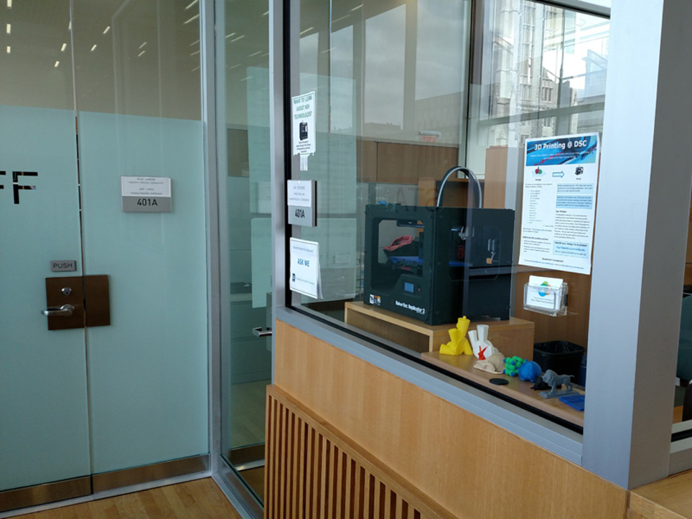

Slide 5
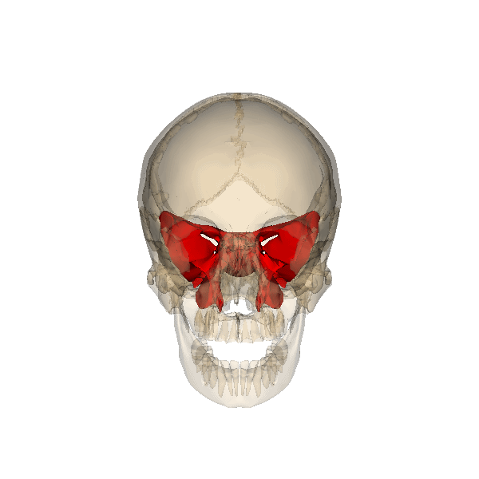

Slide 6
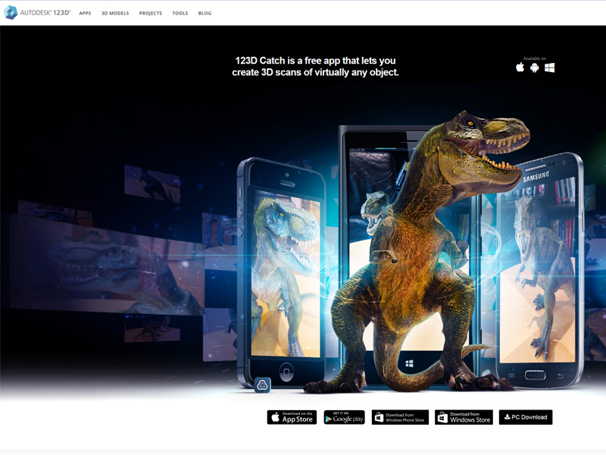

Slide 7
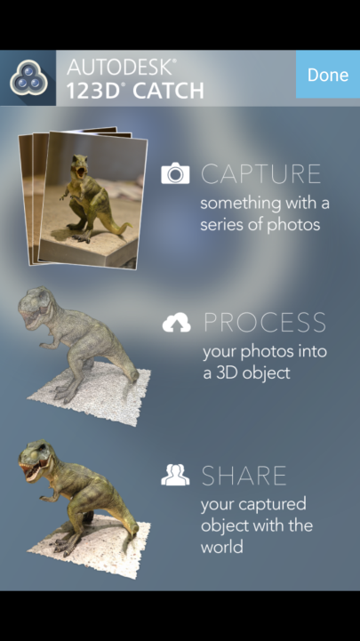
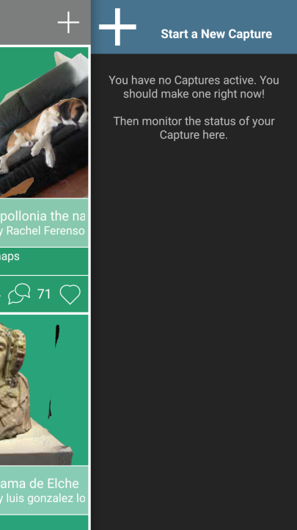

Slide 8
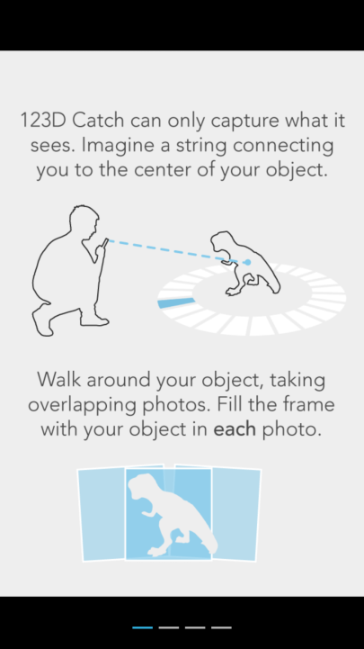
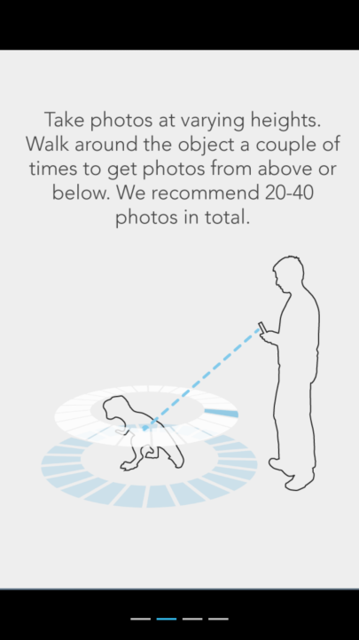

Slide 9
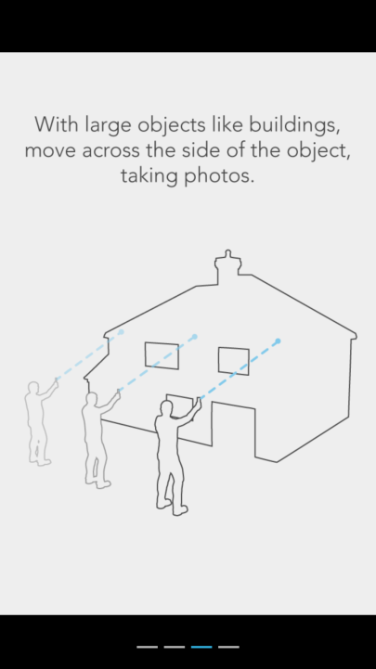
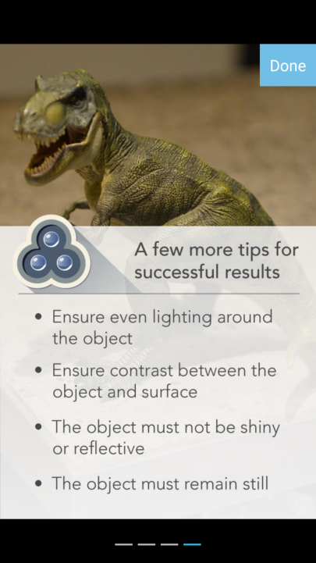

Slide 10
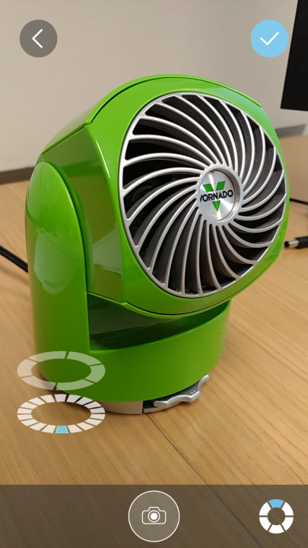
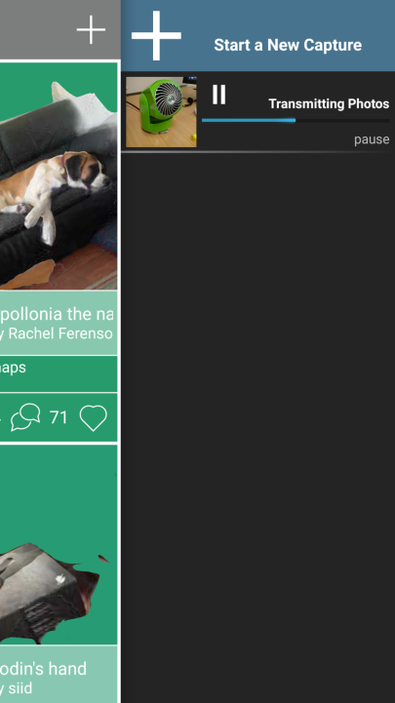

Slide 11
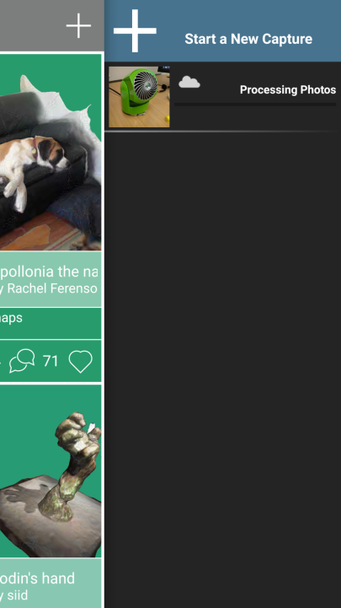

Slide 12
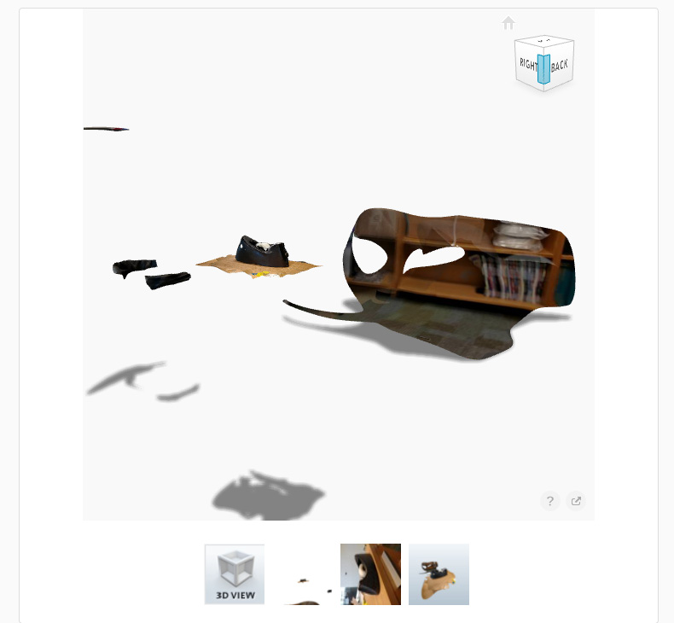

Slide 13
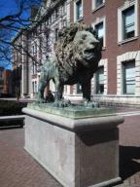
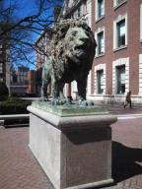
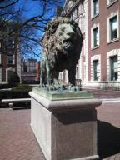
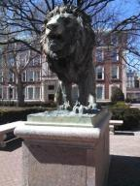
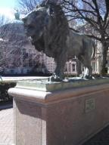
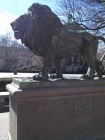
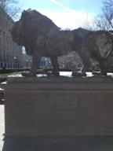
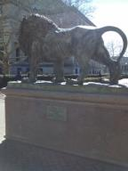
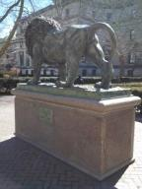
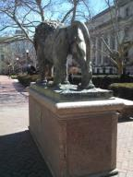
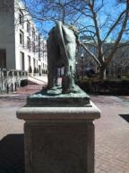
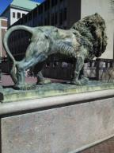
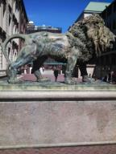
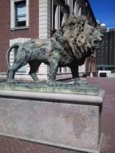
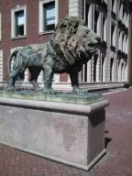
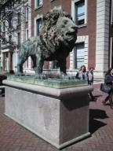

Slide 14
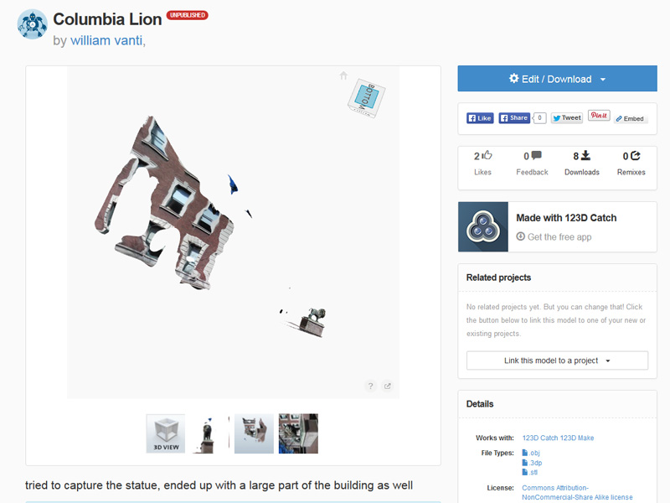

Slide 15
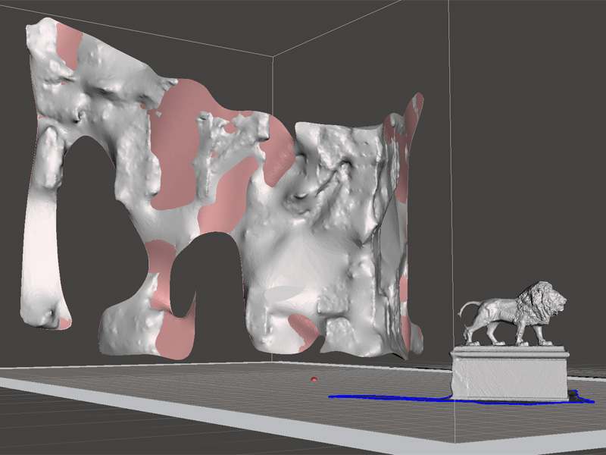
Meshmixer

Slide 16
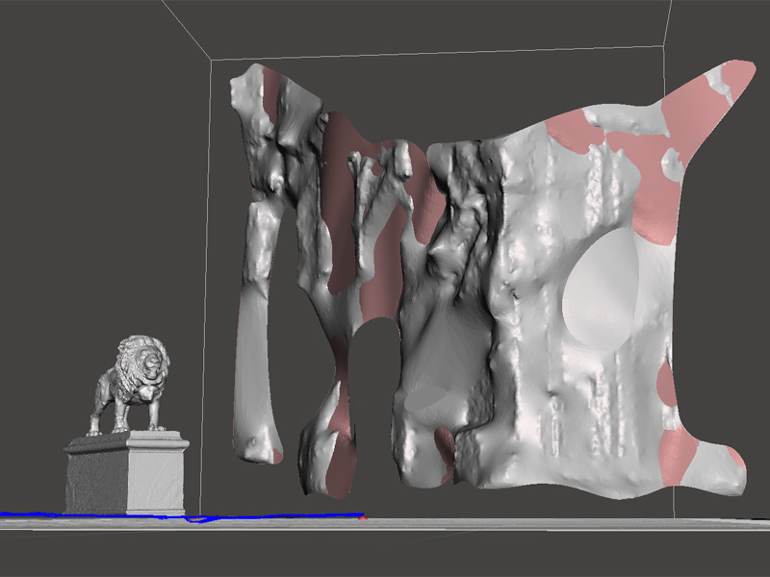

Slide 17
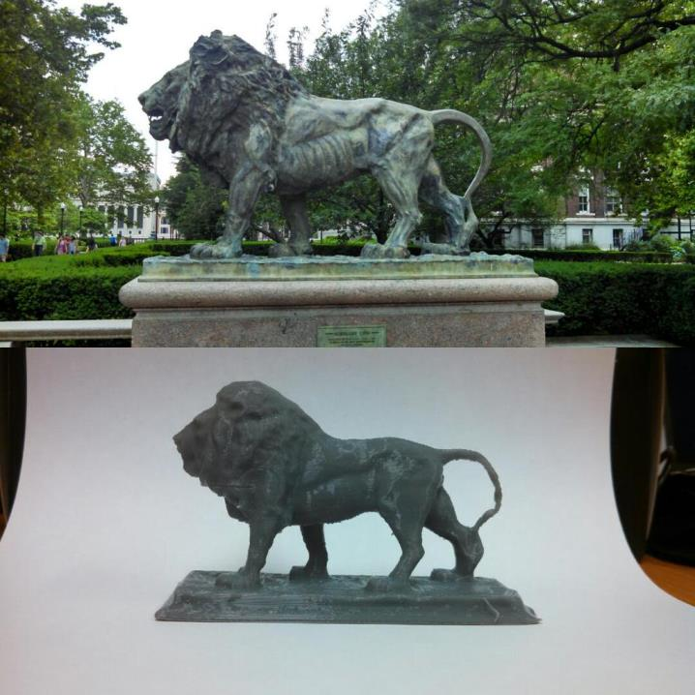

Slide 18
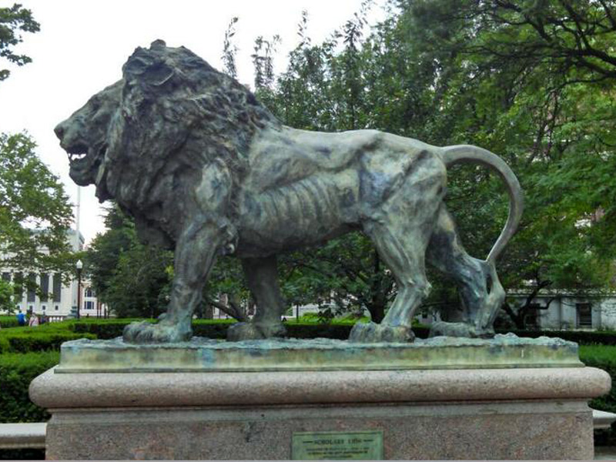

Slide 19
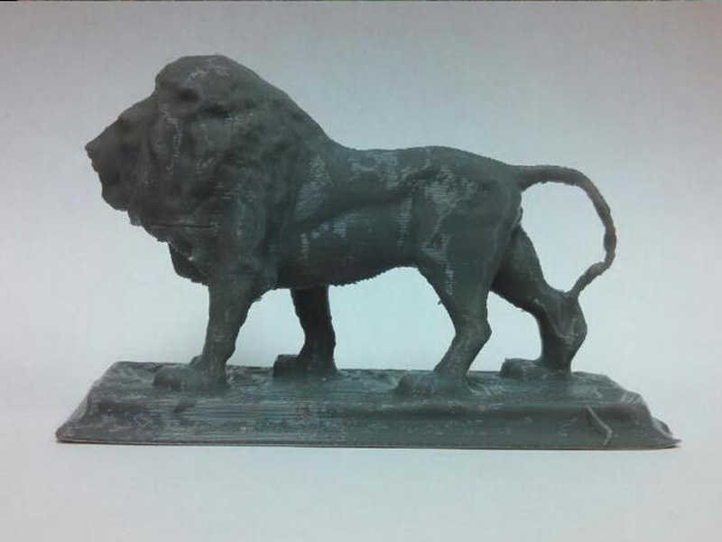

Slide 20
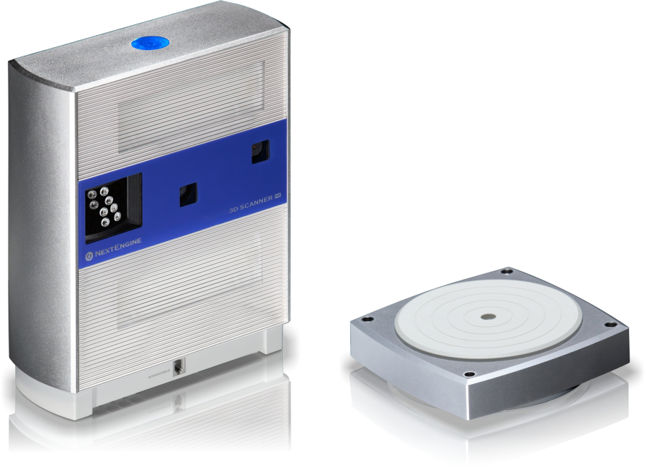

Slide 21
(video removed to reduce file size)

Slide 22
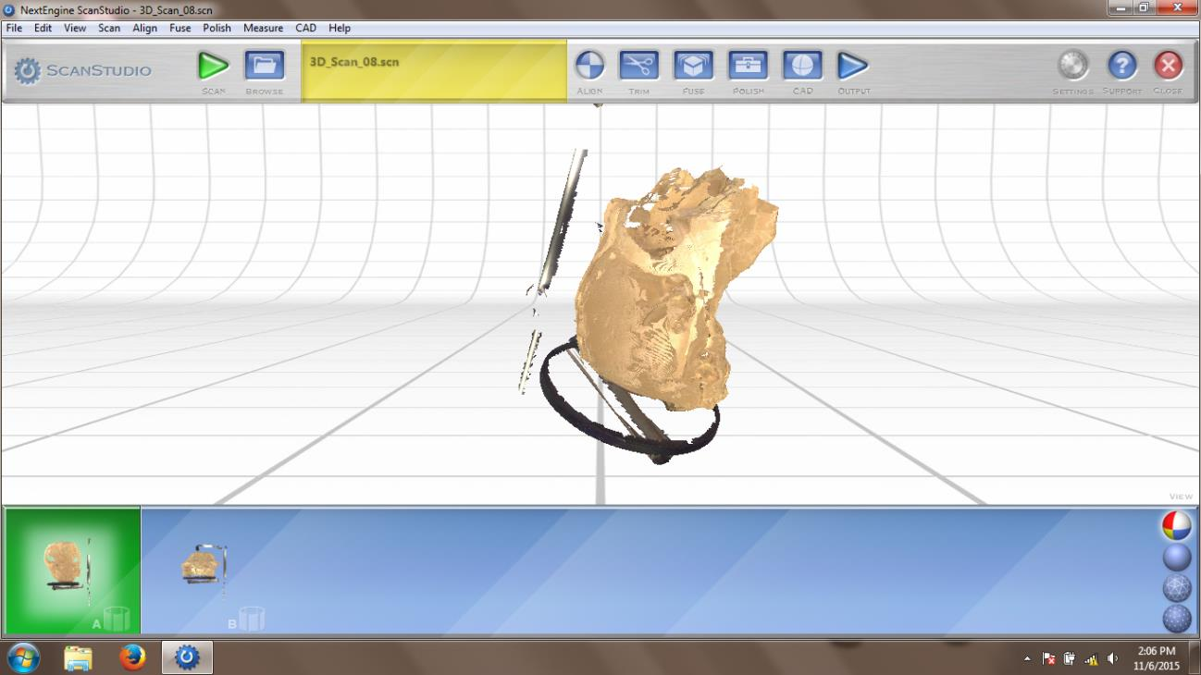

Slide 23
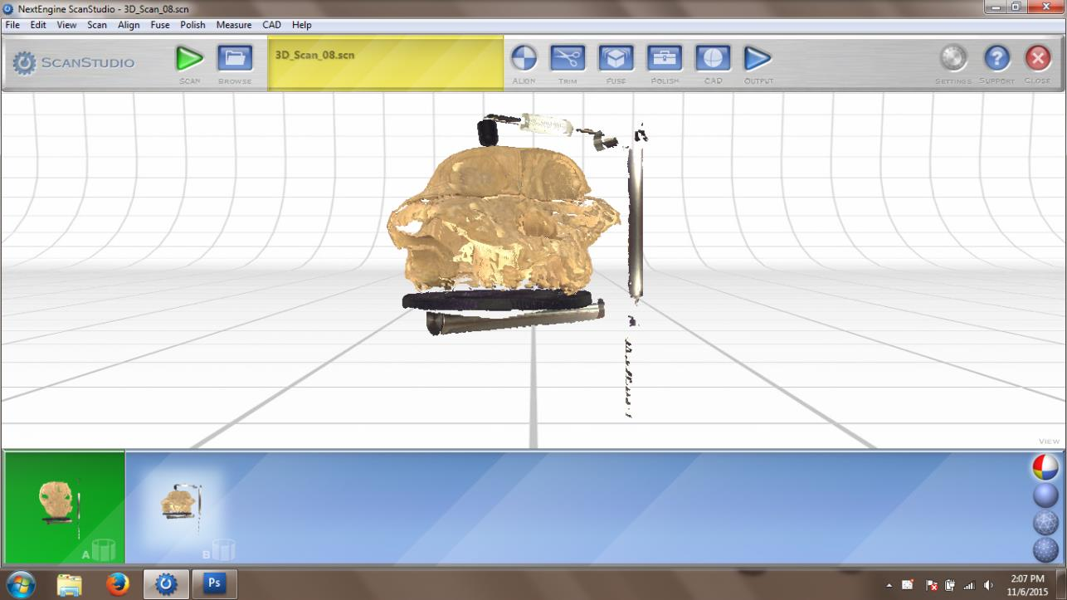

Slide 24
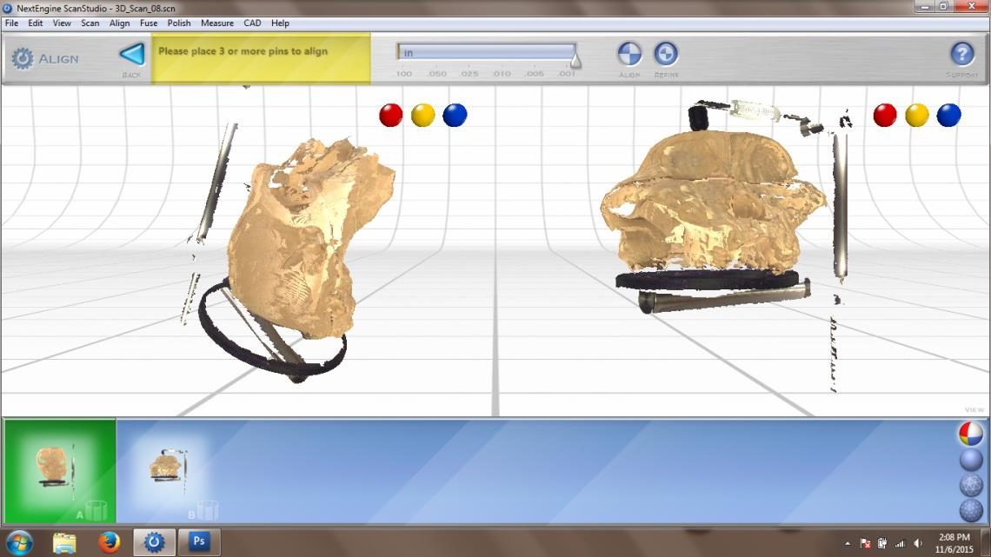

Slide 25
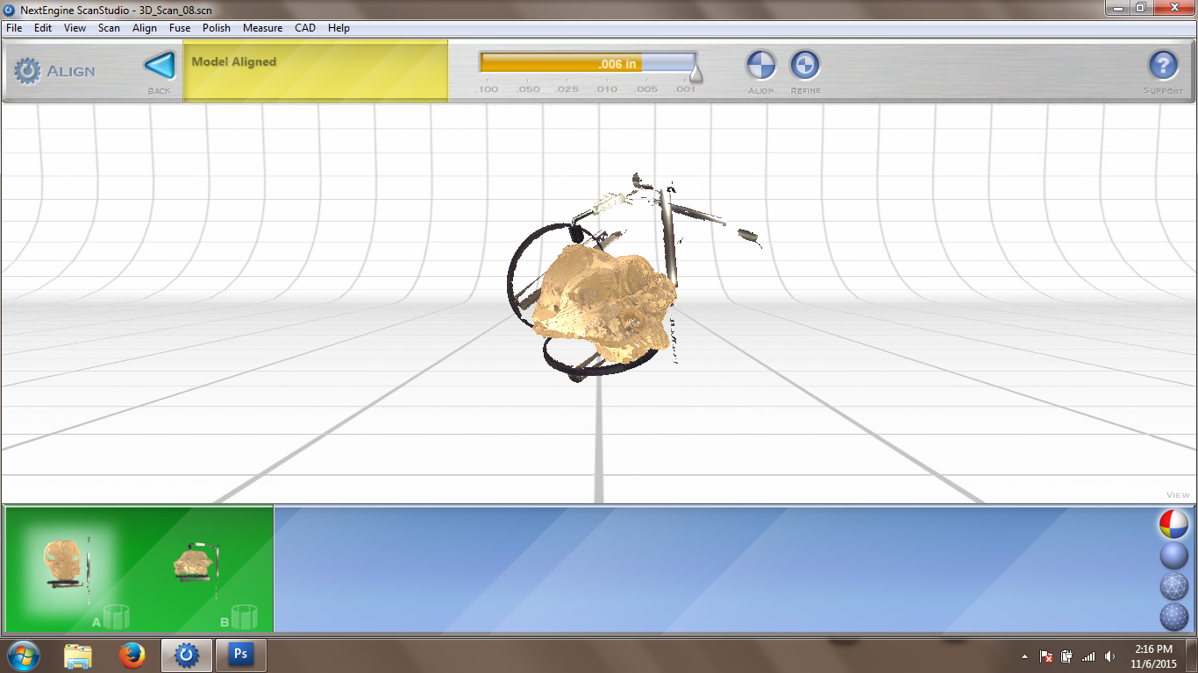

Slide 26
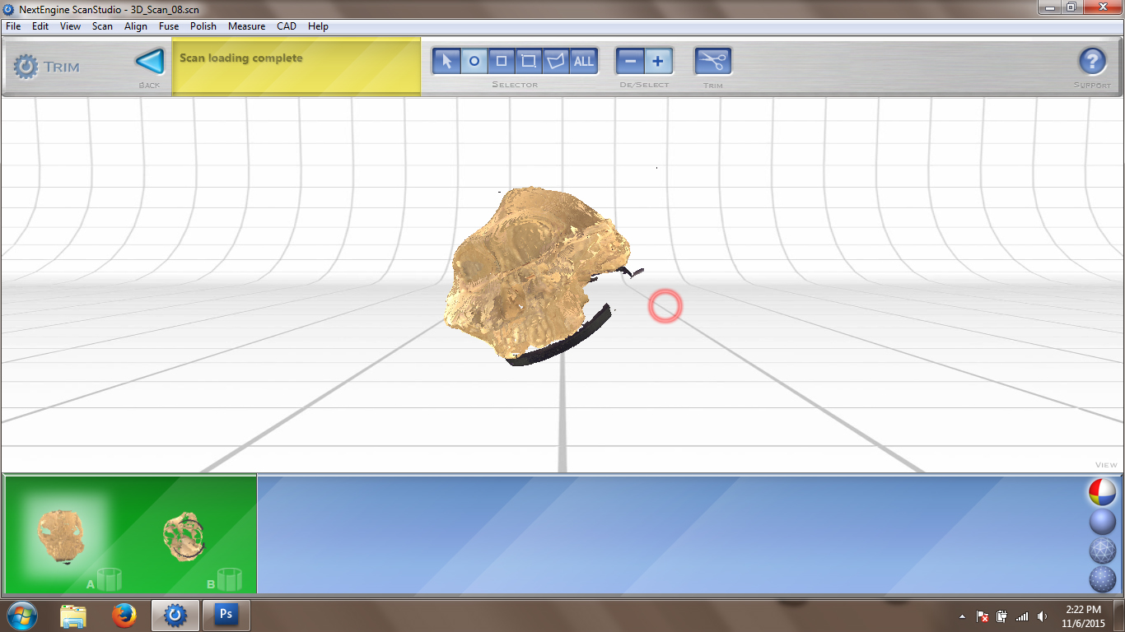

Slide 27
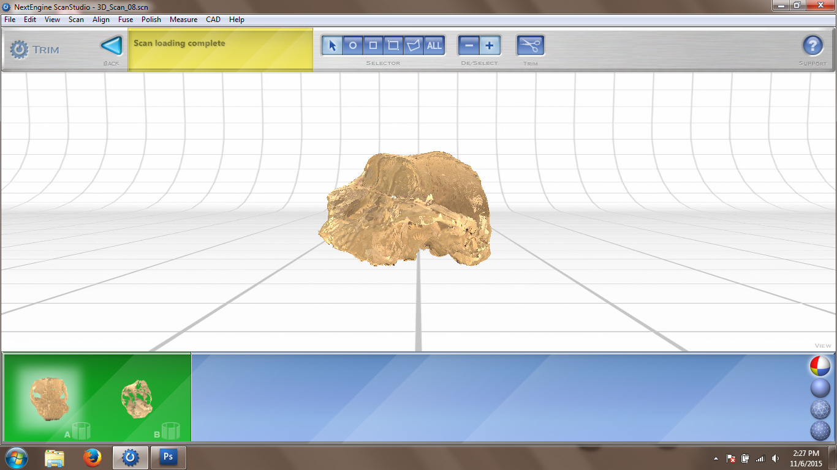

Slide 28
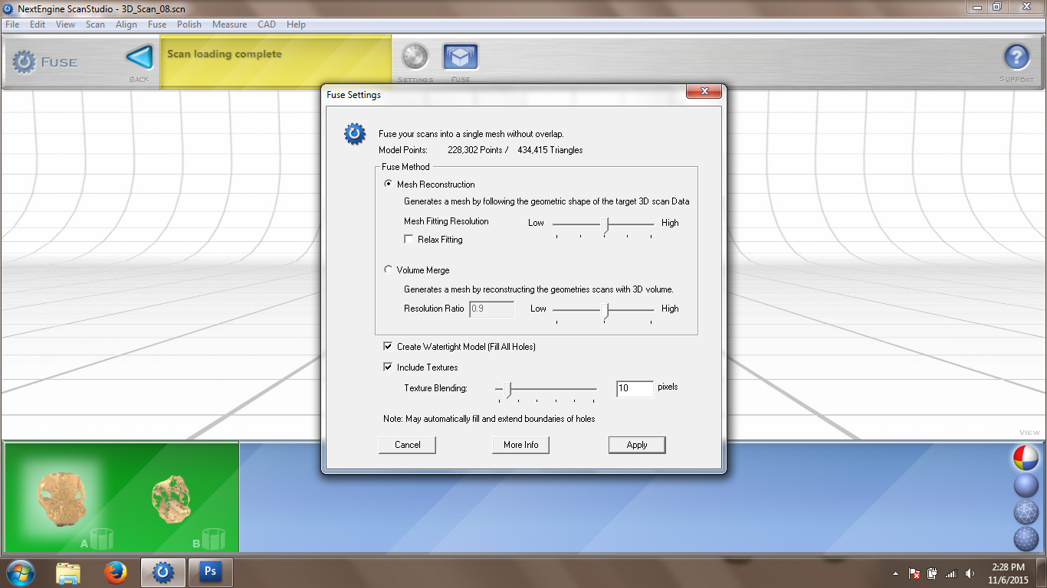

Slide 29
VS
No good for 3D printing
“watertight” models

Slide 30
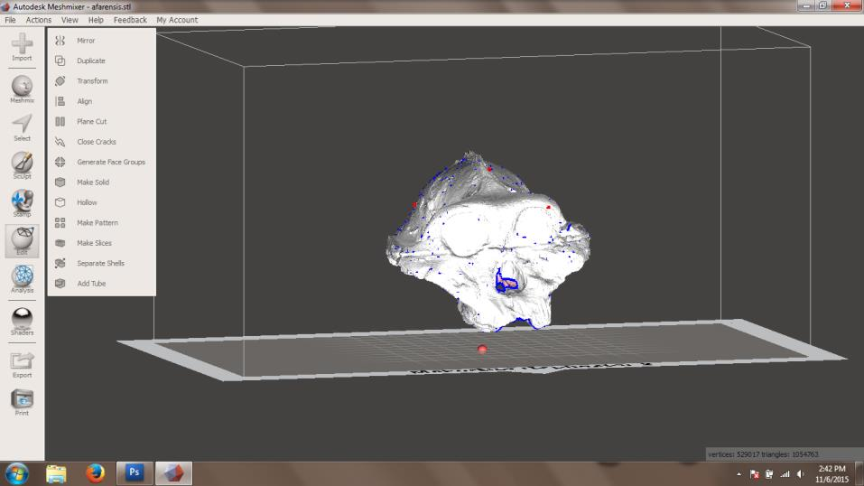
Meshmixer

Slide 31
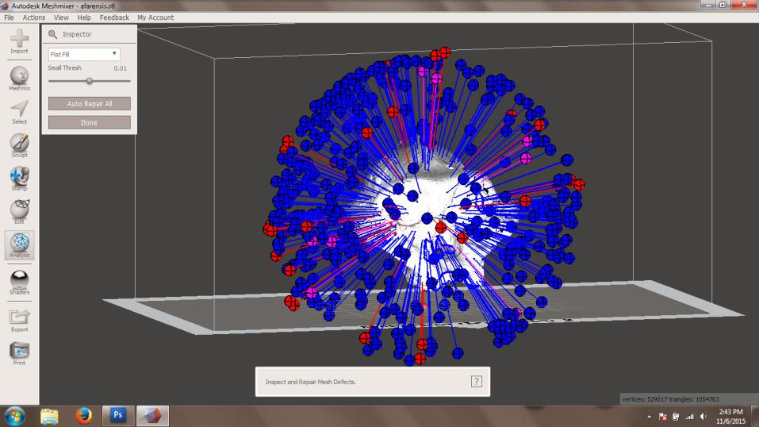

Slide 32
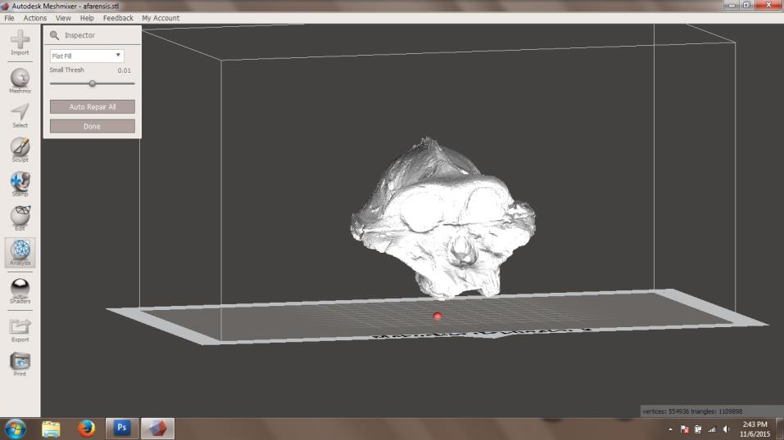

Slide 33
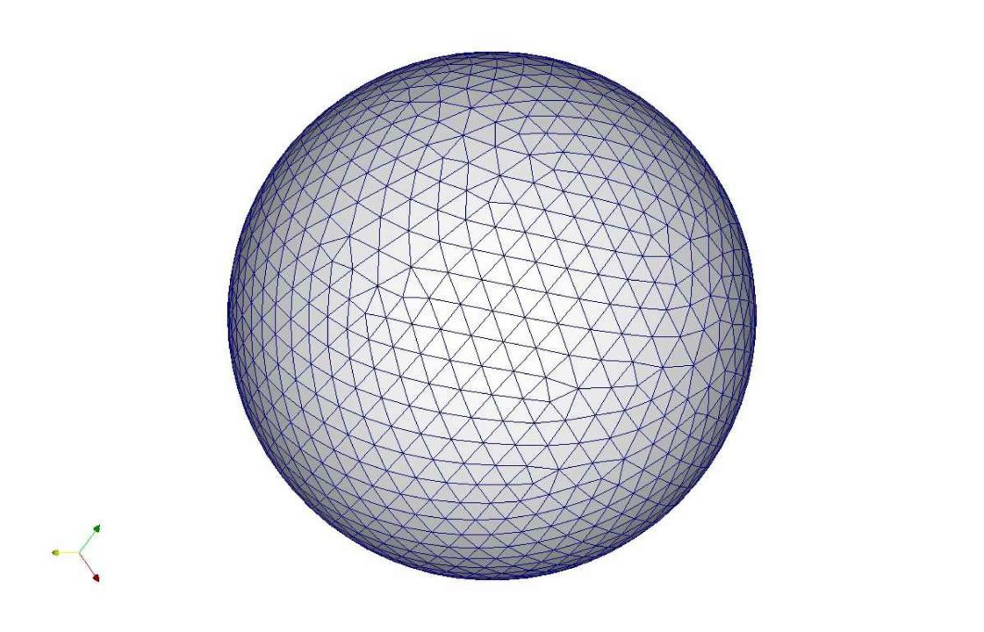

Slide 35
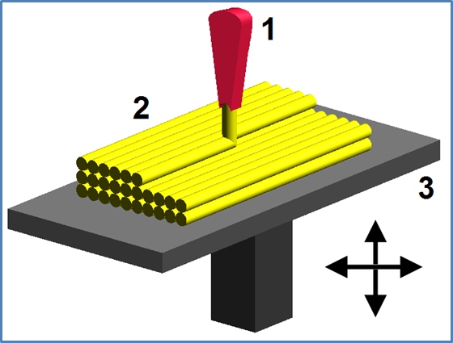

Slide 36
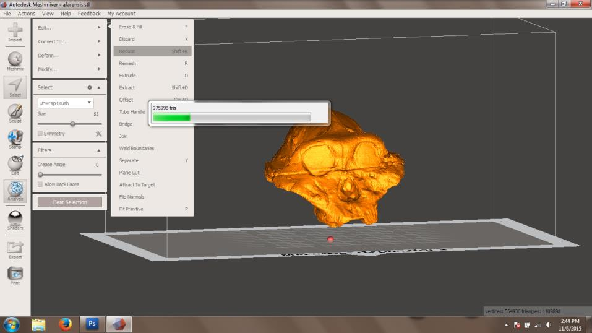
1,109,898

Slide 37
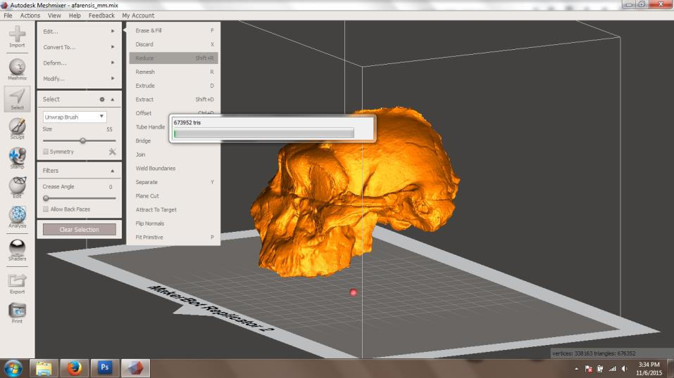
676,352

Slide 38
The “Rules”
From: Watertight Mesh Certification http://syndesia.businesscatalyst.com/watertightmesh-certification.html

Slide 39
Tinkercad
http://www.tinkercad.com

Slide 40
OpenSCAD

Slide 41
Software
Digital Science Center
Free!
SketchUp
AutoCAD
FreeCAD
SolidWorks
Autodesk Inventor
OpenSCAD
Rhino 5
Tinkercad
Blender
3D Studio Max

Slide 42
Use clio.columbia.edu

Slide 43
[software name] + lynda.com

Slide 44
[software name] + lynda.com

Slide 45
clio.columbia.edu/ebooks

Slide 46
3dprint@libraries.cul.columbia.edu
http://3dprint.cul.columbia.edu

Slide 47
Amanda
Ellie
Jennifer
Jim
Krystie
Will
We’re here to help.
ref-sci@columbia.edu

